Slide 1

Redefining Inclusion
Classroom Strategies to Support Inclusion and Manage Dyslexia
Mark Thompson
mark.thompson1@pearson.it
335-599-2568
Notes:
1

Slide 2

Hidden Talents
Do you recognize anyone in this video?
Notes:
1

Slide 3
Your Experiences
Do the comments in the video remind you of anything you’ve heard in the teacher’s room?
http://dyslexia.learninginfo.org/famous-people.htm
Notes:
1

Slide 4
What is dyslexia?
Notes:
1

Slide 5
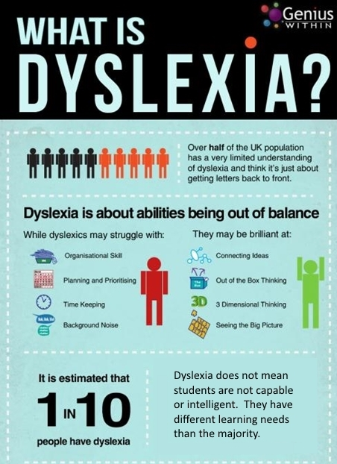
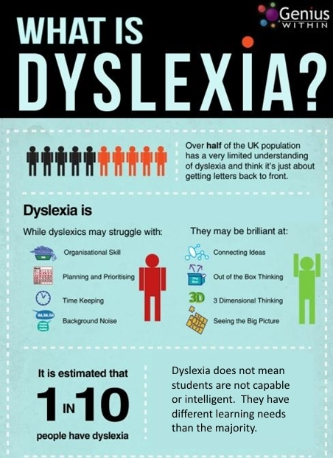
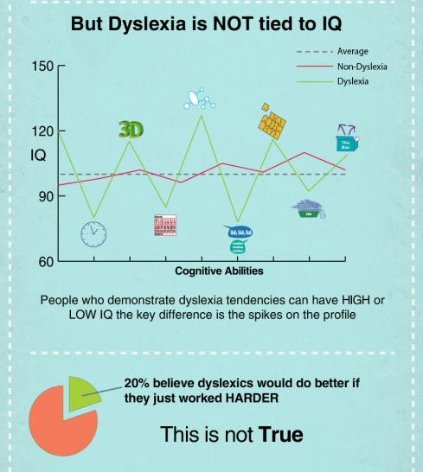
Definitions
What is dyslexia?
also
What is it not?
Notes:
1
This is a little infographic on Dyslexia
Points to remember: expand on the main points: Organisational skills – clear instructions, cutting out jargon and teacher talk and being concise; specific instructions are important for these students,organisational skills – expecially important when it comes to homework; time allowance – the teacher should be catering for this when planning lessons; background noise – a hindrance and distraction to all, and not always easy to deal with but focusing attention on specific points and making sure activities and planning take into account the environment in and around the classroom.
Seeing the big picture & connecting ideas: making sure, as a teacher, you are providing the context and application in real life of whats being studied, situational examples are especially important here and they should be varied.

Slide 6
Demographics
Close to 8m students in Italy
Roughly 3-5% of the population, by some estimates, may be classified as DSA
Officially: Primary: 44.8K; Sec 1°: 73.5K; Sec 2°: 68K
Potentially 250,000 – 350,000 students
About 1 student per class
Notes:
1
There are approximately 7.3 million students in italy within primary and secondary education. Those with verified learning difficulties are about 4/5% of the student population – between 292,000 and 365,000 students. That is at least 1 per class in all schools at all levels. Students with LD are not a rarity.

Slide 7
Signals
Some possible signs of dyslexia
Has low self-esteem.
Has difficulty following lessons, especially long, theoretical discussions.
Doesn’t take notes.
Repeats errors.
Does better on oral than written tests.
Seems slow.
Finds it hard to explain grammar rules.
Is careless or easily distracted.
Has trouble studying independently.
Is forgetful.
Doesn’t like reading.
Notes:
1

Slide 8
Signals
Other Signals
Some possible signs of dyslexia
Is good at listening, especially grasping meaning.
Is good at sport, music, art or other hobbies chosen voluntarily.
Is creative.
Is intuitive.
Is practical.
Notes:
1

Slide 9
The Challenge
“La scuola italiana sviluppa la propria azione educativa in coerenza con i principi dell’inclusione delle persone e dell’integrazione delle culture, considerando l’accoglienza della diversità un valore irrinunciabile.”
Notes:
1
But why should we be making such a big deal out of it all? Why do we care? Because quite simply EDUCATION IS FOR EVERYONE. Why shouldnt it be. The MIUR even states that: (read quote)
We need to be able to take this primary notion on as part and parcel of what we do if we want to successful provide a positive learning environment to our students

Slide 10
Misconceptions
Dyslexia is just a trend.
The student really isn’t very good in school.
He/She doesn’t apply himself/herself enough!
They’re in the wrong school.
They never pay attention in class!
How can I justify giving a special task or tool (computer) to one student and not the others?
All good reasons for teachers to…
offload the responsibility onto their students.
Notes:
1
There are approximately 7.3 million students in italy within primary and secondary education. Those with verified learning difficulties are about 4/5% of the student population – between 292,000 and 365,000 students. That is at least 1 per class in all schools at all levels. Students with LD are not a rarity.

Slide 11
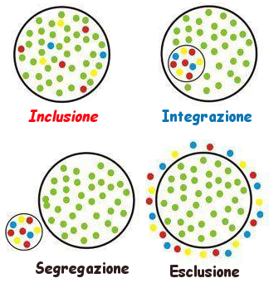
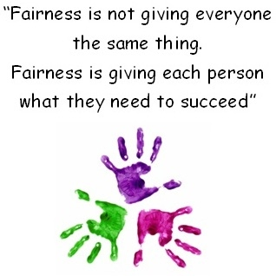
What is inclusion?
Does it mean all doing the same thing?
Does it mean never separating students?
Which diagram/comment do you feel is a better model of inclusion?
Notes:
1
Which means quite simply that INCLUSION is fundamental to what we do and how we do it when it come to teaching. But that also means that WE need to understand and be aware of the various sub groups and categories that make up the students in our schools, our classes and be able to manage them accordingly.

Slide 12
Implications for Teachers
Spoken vs written
Think about the impact of teaching through oral or written methods on your students.
Inclusion
Not simple differentiation by activity but as much integration as possible.
Personalisation
Not generalization: Each student has different strengths and challenges that require different methods and materials to bring out their best.
Learning Styles
Consider the impact of learning styles and the interaction with your teaching style: Linguistic; Aural; Kinesthetic; Spatial; Logical; Social; Solitary.
Notes:
1
So who are they? Well, lets look again at the official indications : SLD , foreign Students and Special Needs.

Slide 13
Managing Dyslexia in the English Class
Notes:
1

Slide 14
Opaque or Transparent
Transparent ones have a close, even one-to-one, relationship between graphemes (letters) and phonemes (sounds).
This makes literacy easier to achieve.
English, unfortunately, is very opaque.
Why is English language teaching a challenge in terms of dyslexia?
Spelling, syllables and discrepancies between spelling and pronunciation make it tricky.
Languages can be classified on a continuum from opaque to transparent.
Notes:
1
Foreign languages for students with LD offer particular challenges english like french result as being unfortunate in this way especially if compared to German or Spanish which are more linear in terms of spelling and pronunciation but this DOES NOT MEAN THEY CANNOT LEARN A SECOND or EVEN THIRD LANGUAGE. It is up to the teacher to make sure we are providing the conditions to allow the student to do so.
English is very regular for the most part of vocabulary in terms of spelling; the problem is that the most common words tend to be older and come from other languages, hence there are many exceptions that make little sense to L2 speakers.

Slide 15
Planning
Considerations for English Teachers
How can I teach a truly “inclusive” lesson?
Which activities are best suited?
Which activities can create difficulties?
How can I adapt material to work for all students?
Notes:
1

Slide 16
Teaching a truly “inclusive” lesson
Strategies
Introduce one concept at a time.
Supply clear models of language.
Use pair and group work.
Use colors, shapes and fonts that help – technology.
Don’t over-focus on grammar rules.
Follow routines.
Include revision in planning.
Notes:
1

Slide 17
Which activities/materials are best suited?
Maps: Concept/vocabulary/grammar/communication.
Total physical response.
Shorter exercises.
Built-in revision and recycling of language.
Speaking and listening.
Interactive exercises.
Any technology that supports students with text: ITE Plus, LMSs/Platforms.
Notes:
1

Slide 18
Which activities can create difficulties?
Reading aloud.
Taking notes and copying from the board.
Difficult questions and those subject to interpretation.
Translation.
Word transformations.
Written exercises in general.
Surprise tests.
Notes:
1

Slide 19
Adapting Materials
Offer choice of activities and topics to engage learners.
Turn a written exercise into a spoken one.
Use different evaluation formats.
Change the font of your own handouts:
12 or 14; Arial, Comic Sans, Verdana, Times New Roman; one column.
Notes:
1

Slide 20
Activities: Functional and Dysfunctional
Notes:
1

Slide 21


Building Inclusion into Planning
In class…
… and at home.
Notes:
1

Slide 22



Technology in the Class
Notes:
1
SO lets begin with the classroom – where we dedicate or up until now, have dedicated the majority of our energy in terms of preparation and creativity. Digital really is a source of support and material for Inlcusion. And if you are not up to speed as yet then I would strongly suggest you do so. So let’s begin with the classroom and the LIMBook / active book. For two very simple reasons: the first is that it offers a wonderful resource for ALL students to work with but secondly it includes functionalities which are of SPECIFIC benefit to LD learners.
ITE Plus functionality.

Slide 23
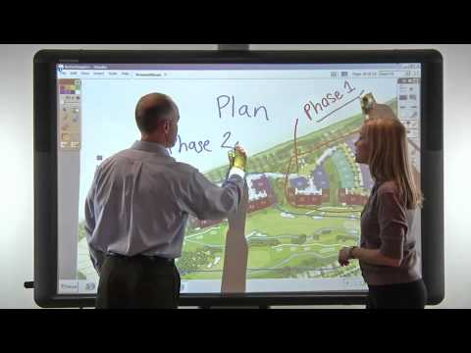
IWB
Engaging presentation of lessons
Focus on one exercise at a time
Multimedia
Highlighting
Notes
Phonetics
Games
Why use the IWB?
Notes:
1
SO lets begin with the classroom – where we dedicate or up until now, have dedicated the majority of our energy in terms of preparation and creativity. Digital really is a source of support and material for Inlcusion. And if you are not up to speed as yet then I would strongly suggest you do so. So let’s begin with the classroom and the LIMBook / active book. For two very simple reasons: the first is that it offers a wonderful resource for ALL students to work with but secondly it includes functionalities which are of SPECIFIC benefit to LD learners.
ITE Plus functionality.

Slide 24

Technology at Home
Why encourage technology use at home?
Engaging Self-study
Interactive exercises
Guide your lesson planning
Track progress to give better feedback
Remove obstacles like text size and font
Notes:
1
SO lets begin with the classroom – where we dedicate or up until now, have dedicated the majority of our energy in terms of preparation and creativity. Digital really is a source of support and material for Inlcusion. And if you are not up to speed as yet then I would strongly suggest you do so. So let’s begin with the classroom and the LIMBook / active book. For two very simple reasons: the first is that it offers a wonderful resource for ALL students to work with but secondly it includes functionalities which are of SPECIFIC benefit to LD learners.
ITE Plus functionality.

Slide 25
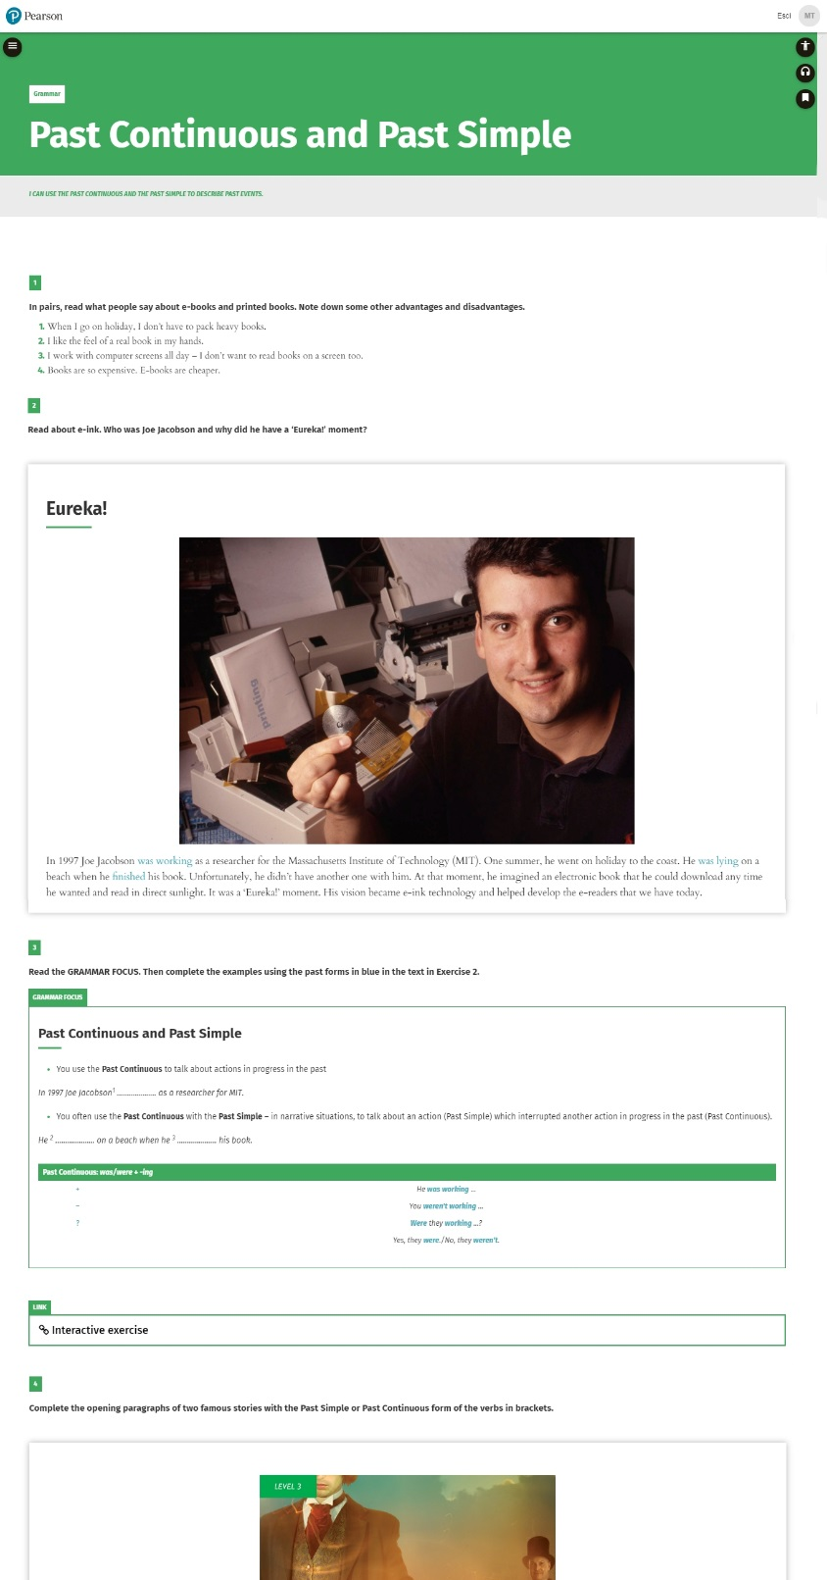
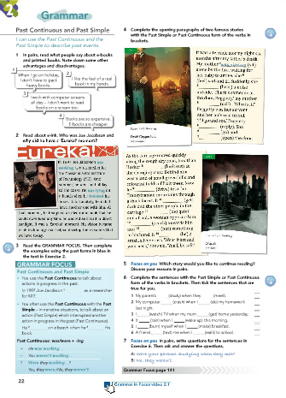
What to use
Texts:
Short and clear.
Use closed questions for comprehension including T/F or multiple choice.
Avoid all ambiguity.
Notes:
1
Dyslexia and Linguistical ability
Reading: texts must be short and clear. Use closed questions for comprehension including T/F or mulitple choice, and additional time allowance: phrases should be short, and avoid all ambiguity. Discrimate double negatives/ specific wording etc etc
Writing: Guided. Including hints/tips for lexical items, grammar structures and above all ample time available
Listening: Listening should not be a problem – but make sure comprehesion questions are “closed”. Provide time allowance and repeated listening opportunities.
Speaking: Provide a guide, scheme or hints to aid in Vocab recall.

Slide 26
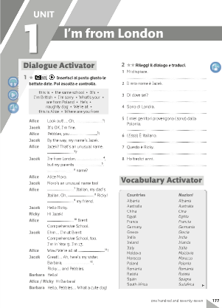
What to use
Writing:
Guided.
Include hints/tips for vocabulary.
Give ample time.
Notes:
1
Dyslexia and Linguistical ability
Reading: texts must be short and clear. Use closed questions for comprehension including T/F or mulitple choice, and additional time allowance: phrases should be short, and avoid all ambiguity. Discrimate double negatives/ specific wording etc etc
Writing: Guided. Including hints/tips for lexical items, grammar structures and above all ample time available
Listening: Listening should not be a problem – but make sure comprehesion questions are “closed”. Provide time allowance and repeated listening opportunities.
Speaking: Provide a guide, scheme or hints to aid in Vocab recall.

Slide 27
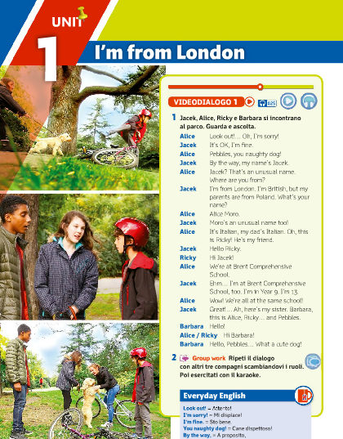
What to use
Listening:
Should work better than writing in general.
Use closed questions.
Allow for repetition.
Notes:
1
Dyslexia and Linguistical ability
Reading: texts must be short and clear. Use closed questions for comprehension including T/F or mulitple choice, and additional time allowance: phrases should be short, and avoid all ambiguity. Discrimate double negatives/ specific wording etc etc
Writing: Guided. Including hints/tips for lexical items, grammar structures and above all ample time available
Listening: Listening should not be a problem – but make sure comprehesion questions are “closed”. Provide time allowance and repeated listening opportunities.
Speaking: Provide a guide, scheme or hints to aid in Vocab recall.

Slide 28
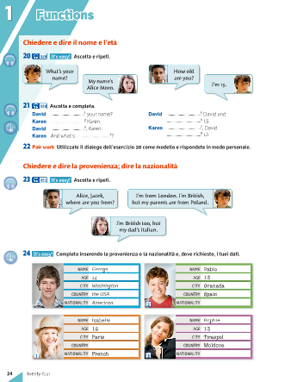
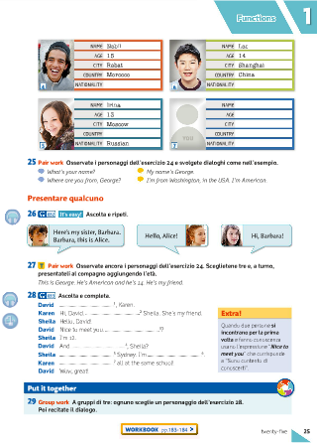
What to use
Speaking:
Provide a model.
Build up from easy to more complex speech, adding more skills step by step (grammar, vocabulary, pronunciation).
Offer hints.
Notes:
1
Dyslexia and Linguistical ability
Reading: texts must be short and clear. Use closed questions for comprehension including T/F or mulitple choice, and additional time allowance: phrases should be short, and avoid all ambiguity. Discrimate double negatives/ specific wording etc etc
Writing: Guided. Including hints/tips for lexical items, grammar structures and above all ample time available
Listening: Listening should not be a problem – but make sure comprehesion questions are “closed”. Provide time allowance and repeated listening opportunities.
Speaking: Provide a guide, scheme or hints to aid in Vocab recall.

Slide 29
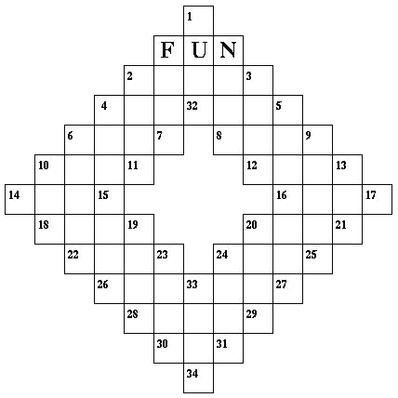

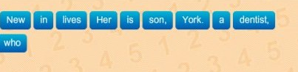
What not to use
Notes:
1
But is is very important to know also which of these materials are NOT suitable for LD students and again which materials could be adapted easily.
So lets take a look at the activites to avoid :
Odd one out
Word ordering
Word puzzles

Slide 30
Assessment
Notes:
1

Slide 31
General Principles
Learning objectives should be the same for all of the class at the group level.
Assessment must be coherent with student’s PLP (personalized learning plan).
Assess abilities, knowledge and attitude
with the correct criteria and tool to give each student
a chance to be successful.
Notes:
1
In terms of testing and evaluation, nothing changes. The learning objectives for the class are THE SAME FOR ALL. Having said that however, it is important to understand also that coherent measures must be made for assessment which coincide with each students Personal Learning Programme . Which is to assess his or her abilities, knowledge and skills in measured criteria and modality.

Slide 32
Practical Guidelines
Personalise – allow choice in activities, each student is individual in terms of type of dyslexia, personality and defense strategies.
Common ground – adapt single activities to suit all; keep same score terms.
Production – evaluate communication objectives not just errors.
Additional time allowance – for all – up to 30% by law.
Allow reasonable aid – verb tables, word lists, digital dictionary.
Notes:
1
Each student is individual in terms of gravity and type of dyslexia, personality and defense strategy
Maintaining the same score terms and objectives is fundamental but adapt singular activities where necessary from the material used for the whole group
When it comes to production above all, we are always trying to trip our students up, focusing on what they get wrong instead of focusing our attention on what they get right. When it comes to students with LD, we MUST focus on and assess what they get RIGHT. And it is something we need to learn to do more often with all of our students. Its not about how many RED PEN marks a student gets, but howe many GREEN TICKS.
During preparation and planning make sure you are allowing suitable time for students with LD. They should not have to deal with time pressure in such high stakes situations
Concede aids: these can aid the student bring forward what he knows, it can trigger the correct mental process for them to display thier capabilities this should not be denied.

Slide 33
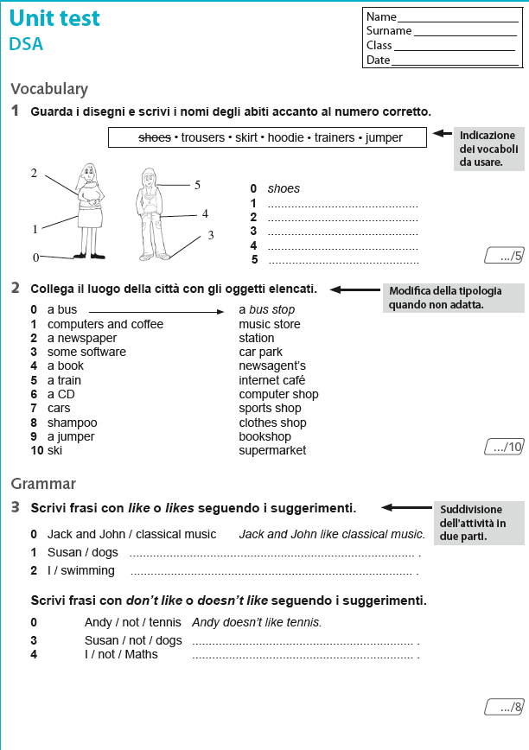
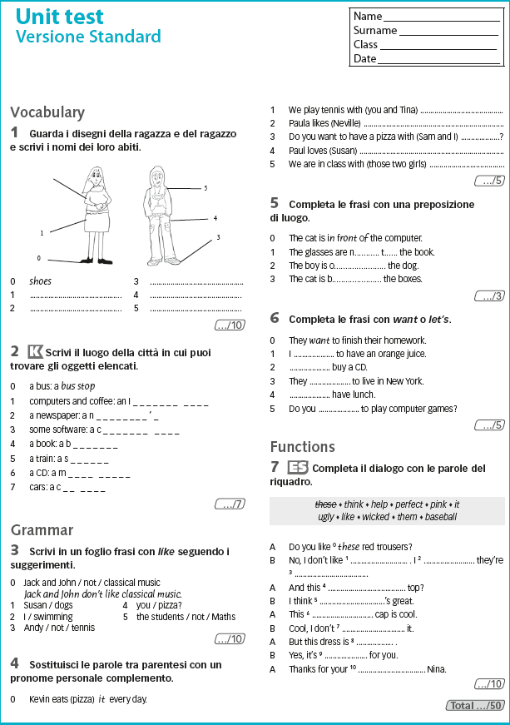
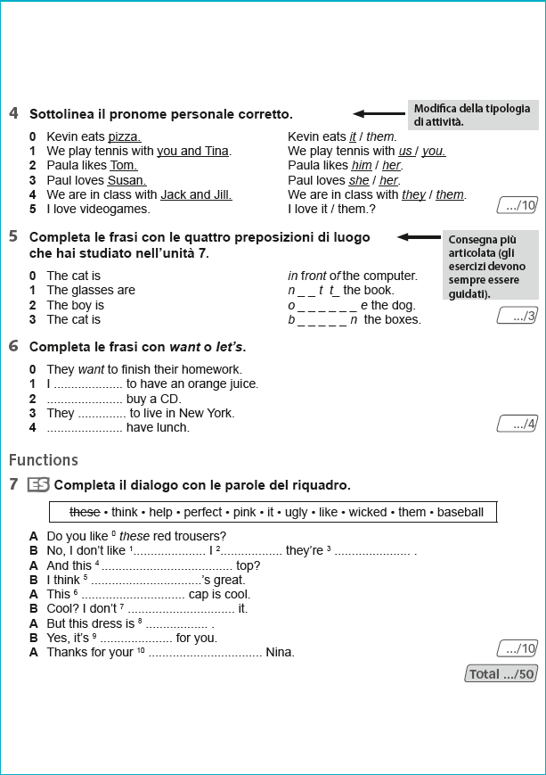
Test Format
Same test adapted for dyslexia
Standard test sheet
Notes:
1
I corsi di lingue straniere Pearson offrono i test e le verifiche anche adattati in versione DSA, secondo i criteri appena visti, sia in versione cartacea, si in formato WORD.
L’insegnante può partire dalla versione WORD adattandoli ulteriormente se necessario, abbreviandoli, modificandoli secondo le esigenze specifiche dei suoi studenti.
Then the same test adapted for DSA (dyslexia) indicate and read the higlighted areas next to each exercise

Slide 34
Other Considerations
Font type and size for written exams.
Provide alternative exam formats – spoken vs written.
Anonymize test-taker identity (prevent marking bias).
Allow a break during exams if they’re long.
Use computer-based testing.
Make sure students are comfortable in terms of ergonomics.
Reduce or eliminate discriminatory criteria (handwriting clarity – just use a computer, spelling).
Allow exams to be taken at home (set time limit and start time).
Notes:
1

Slide 35
Digital Materials
Notes:
1

Slide 36
ITE Tools, Activity Flow and Teacher’s Materials
Focus attention on immediate task
Karaoke options
Talking book
Easy Learning
Modifiable tests
How can the Interactive Tablet Edition (ITE) of coursebooks help students in class and at home?
Notes:
1

Slide 37
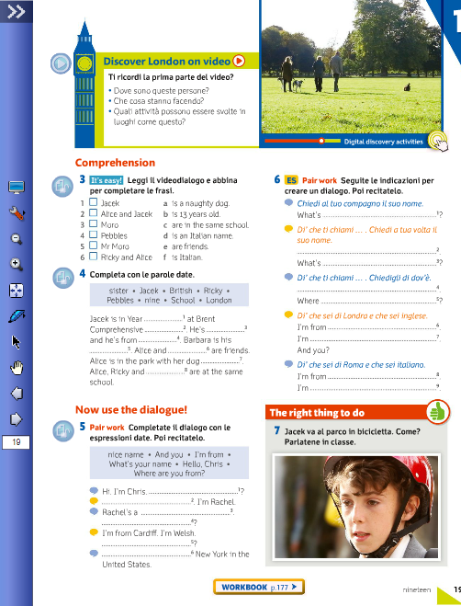
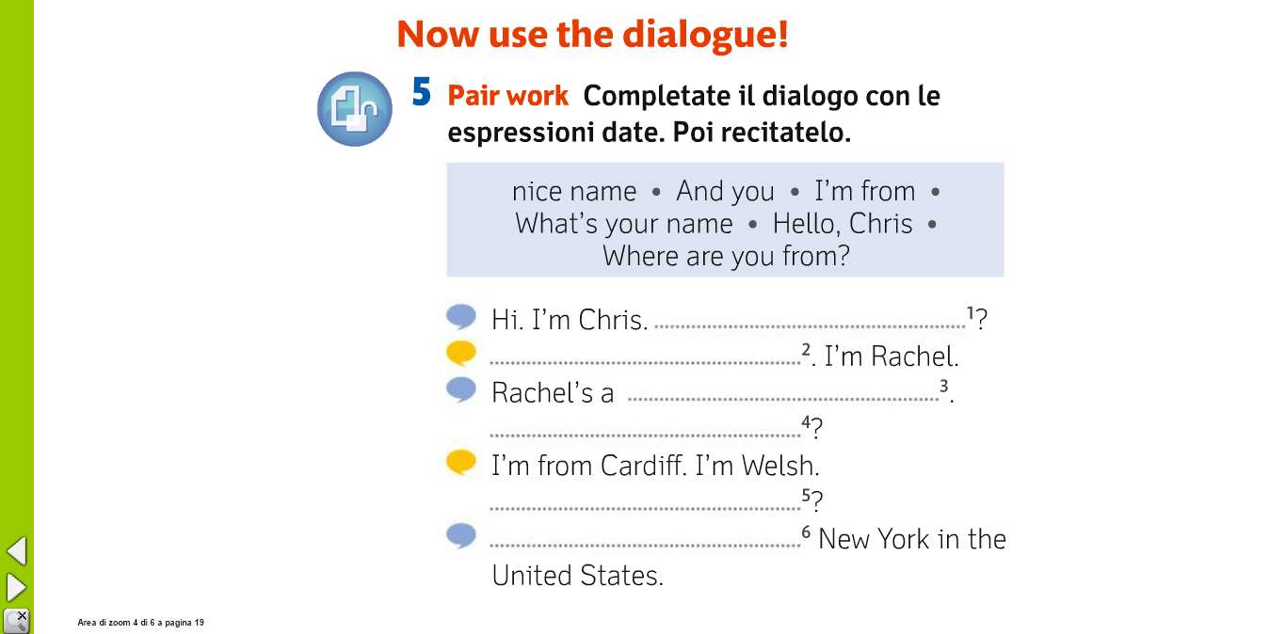
ITE, Activity Flow and Teacher’s Materials
Focus attention on immediate task…
… by clicking and zooming in on it.
Notes:
1

Slide 38
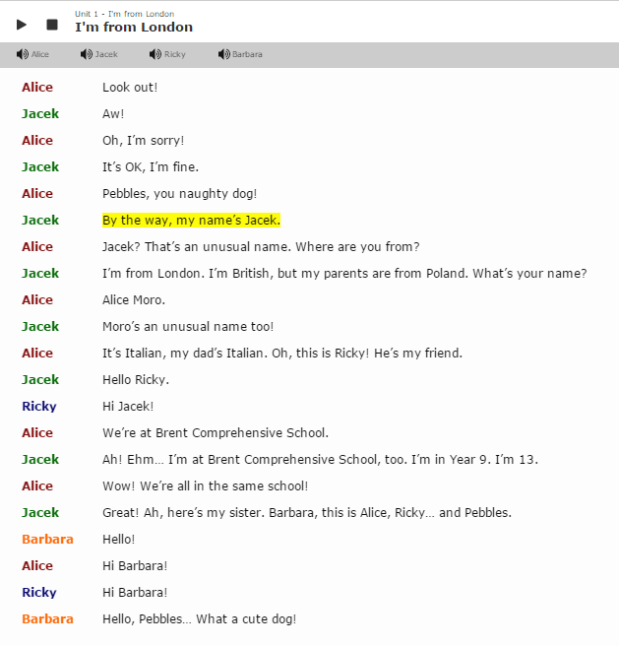
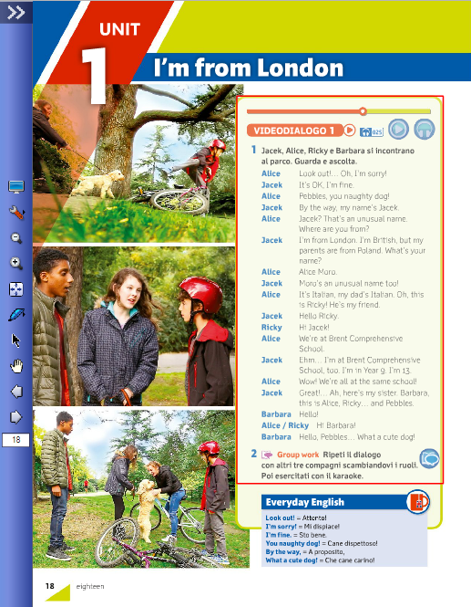
ITE Tools, Activity Flow and Teacher’s Materials
Use karaoke option to help students follow text
Notes:
1

Slide 39
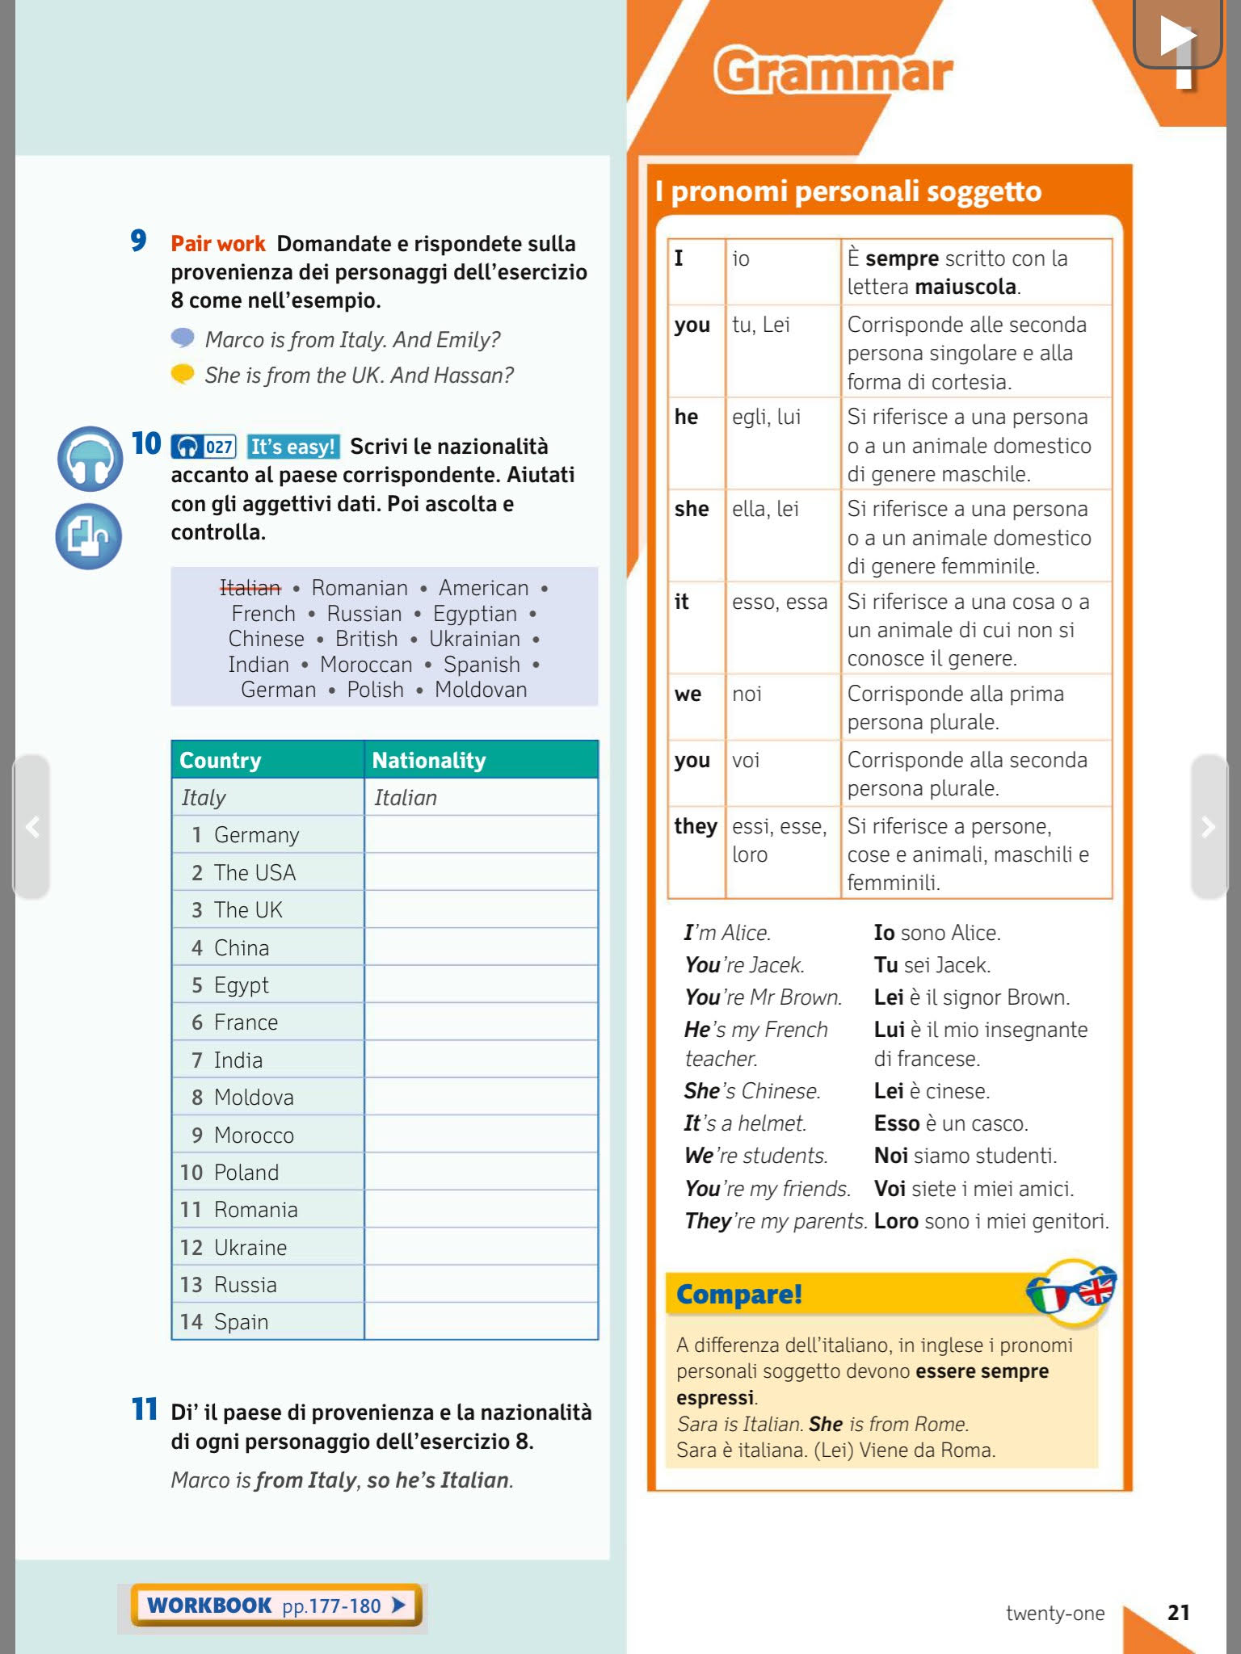
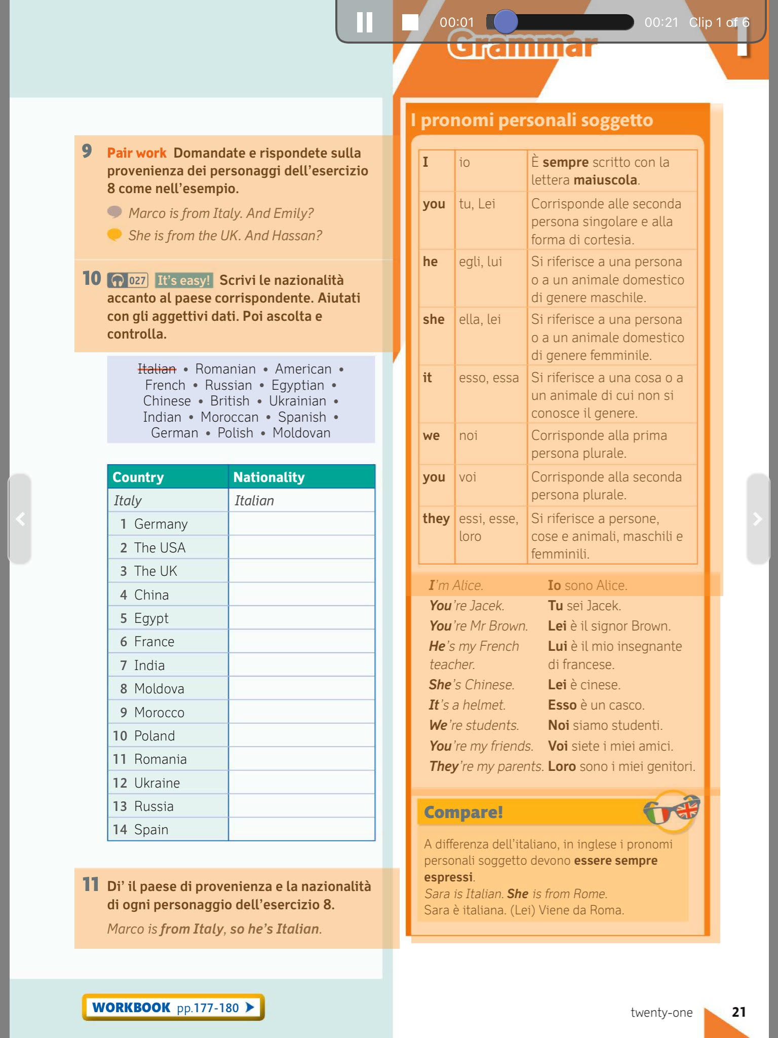
ITE Tools, Activity Flow and Teacher’s Materials
Talking book:
Click and play text audio
Notes:
1

Slide 40
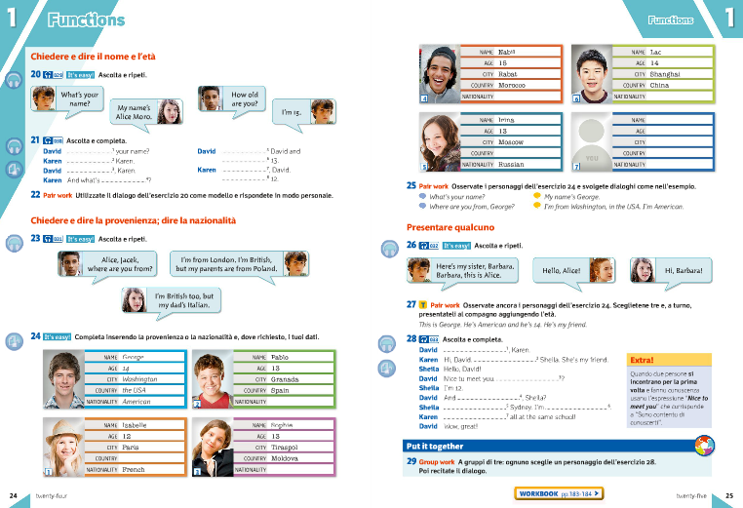
ITE Tools, Activity Flow and Teacher’s Materials
Fundamental Conceps
Choose a task progression adapted for you students
Moderate Challenge
Activity Flow
Extra Challenge
Notes:
1

Slide 41
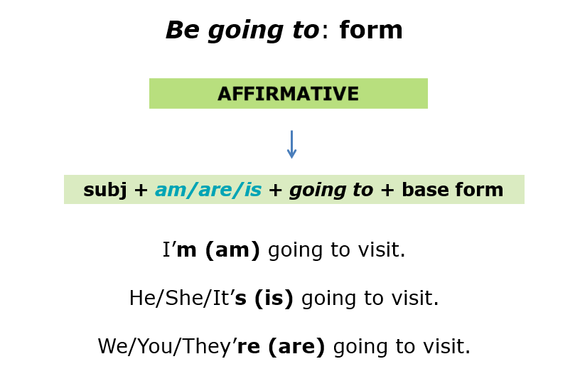
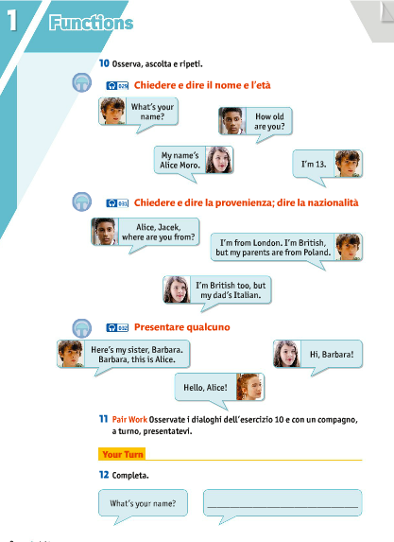
ITE Tools, Activity Flow and Teacher’s Materials
To focus on the fundamental points in the unit.
Grammar, Vocabulary and Function Maps to summarize/review key points
Easy Learning Booklets
Notes:
1

Slide 42
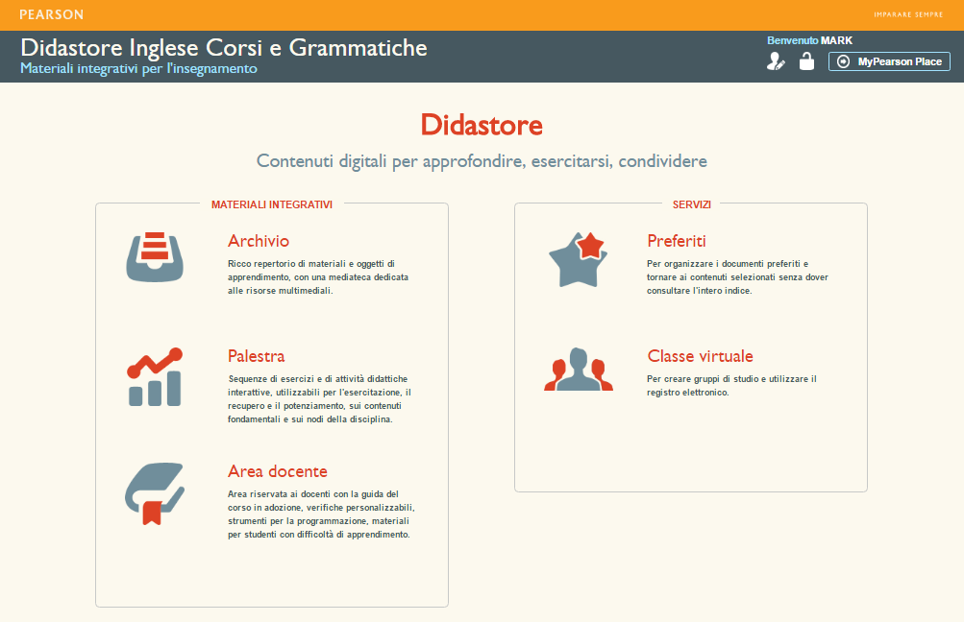
ITE Tools, Activity Flow and Teacher’s Materials
Available in Pearson’s Didastore
Modifiable tests
Notes:
1

Slide 43
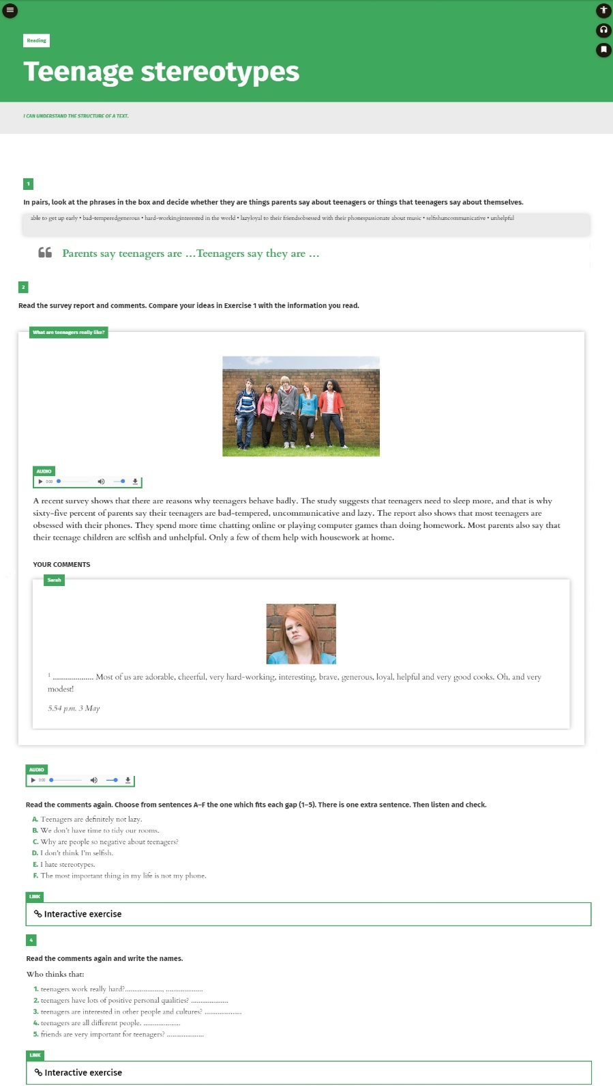
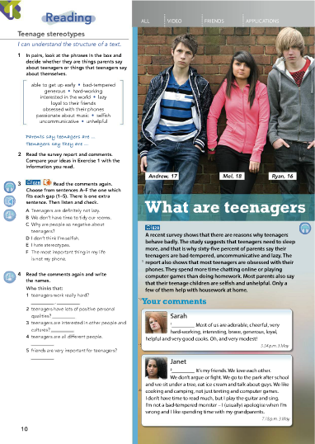
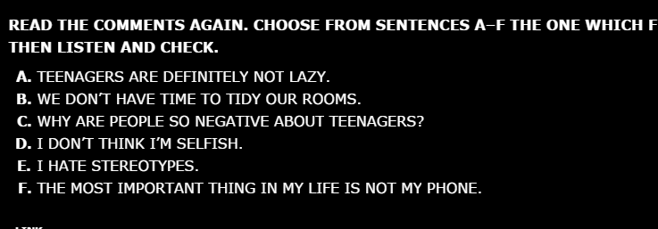
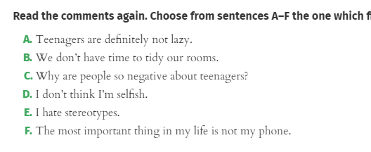
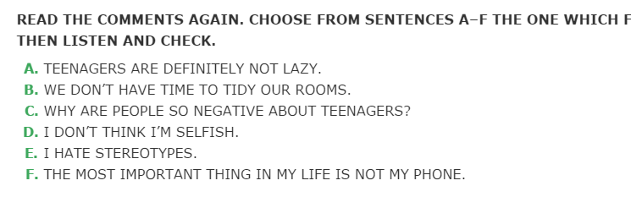

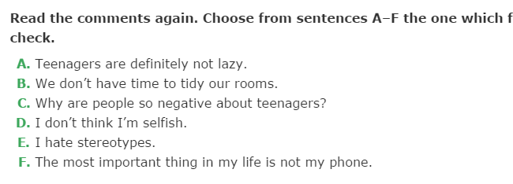



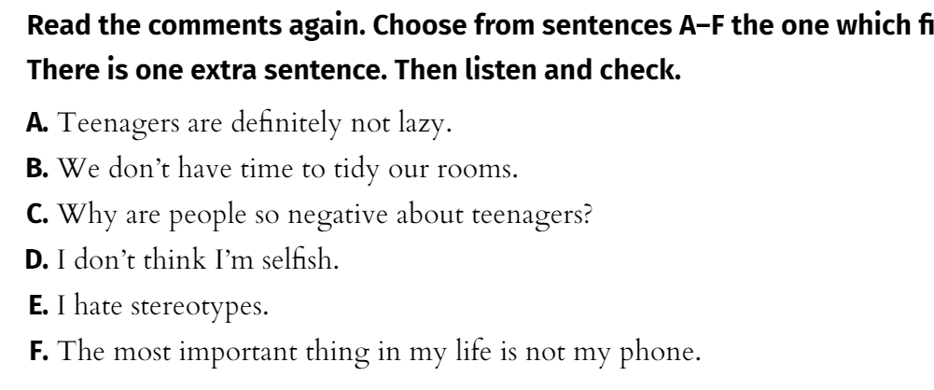
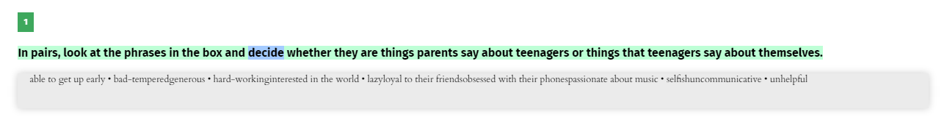
ITE vs ITE Plus
Less graphics and vertical presentation to focus attention
Standard ITE View in class or at home
ITE Plus View to support DSA
Fonts to make reading easier:
Highlighted Text: Follow audio coursebook text and pair sounds with words…
Change Font
ALL CAPITALS
Zoom
High Contrast
…with adjustable audio speed…
…to facilitate reading.
Notes:
1

Slide 44

MyEnglishLab
Reduce time checking homework and get support to pinpoint student strengths and weaknesses.
Use continuous assessment to inform in-class teaching.
Provide students with another learning medium.
Instant feedback and advice to guide learning at home.
A second opinion on student progress.
Notes:
1
Digital use in study should not remain in the classroom. Especially when we know students are connected almost continuously outside the classroom. One of the most successful methods of structuring, managing and helping students deal with thier homework is to use a blended learning platform which deals specifically with the course studied in the classroom:
Explain final points as necessities to make blended learning work for LD students ( funnily they all fall into EXACTLY what MEL does =))

Slide 45
MyEnglishLab
Homework Guidelines
Course Specific
Structured, but personalizable
Opportunities for repetition and/or extension
Inclusive
Clear diagnostic feedback for teacher
Notes:
1
Course specific – it is fundamental that students have continuity between class work and homework – they need to be working on the same structures, explanations, concepts and ideas as they have been in class
Structured: students need to be guided in self study – more so than in the classroom as they are missing the most important element of the class – the teacher. But it needs to be structured also to the individual needs of the student LD or not
Revision, repetition – students need to be able to work at thier own pace especially when without a teacher on hand to keep them steady – they need feedback instantly to be able to make the adjustments they require to move ahead
Feedback – as a teacher to personalise and structure self study work we need a full and complete picture of what the class is doing and also of each individual student so as to react and act upon the needs and requirements of the class and the individual student – but we need it instantly and readily visibile to see and interpret.

Slide 46
MyEnglishLab
The teacher reviews in class
Homework is assigned
The teacher explains in class
Homework is personalized to the class/individual, feedback is given, repetition and extension are possible.
How can homework and digital inform instruction?
The teacher checks the homework and student progress
The student does homework
1
Notes:
Explain how MEL works
1

Slide 47
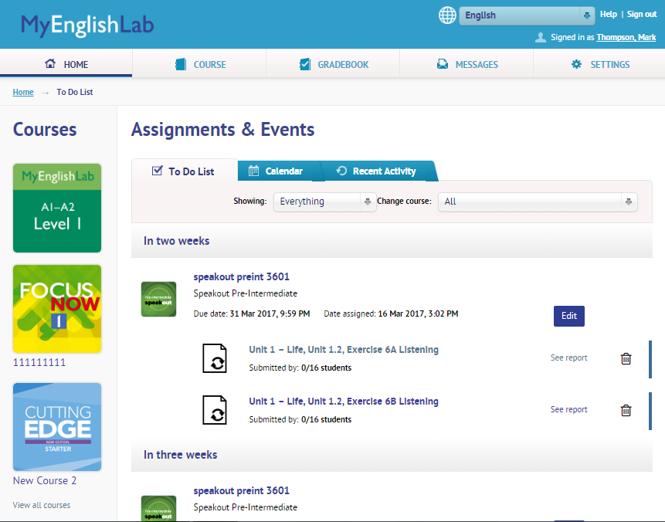
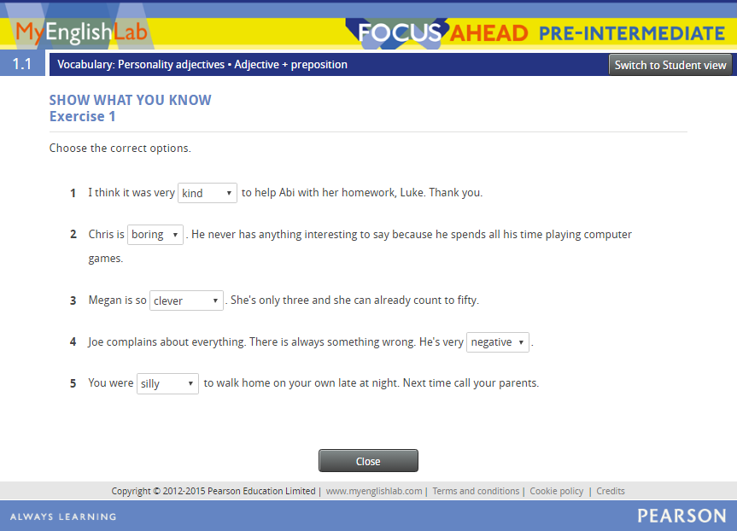
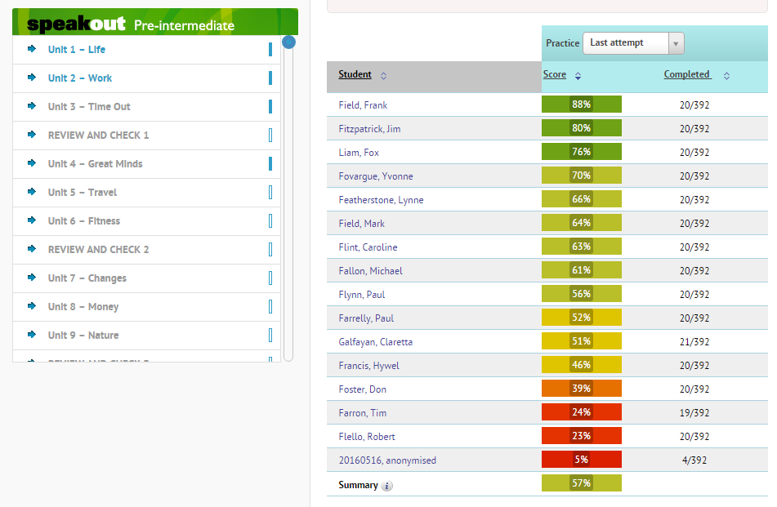
MyEnglishLab
Structured exercises you select based on student needs; format supports DSA challenges
Clear guide as to what to do for students on home page
Quick view of student results
Notes:
1

Slide 48
Summary
Inclusion means thinking about:
Learning styles, hidden talents, personalization
Varying your methodology
Digital resources helping to inform teaching and motivate
Engaging students in the class and at home with interesting topics
Diversity being a strength
Notes:
<numero>

Slide 49
Thoughts?

Slide 51
Redefining Inclusion
Classroom Strategies to Support Inclusion and Manage Dyslexia
Mark Thompson
mark.thompson1@pearson.it
335-599-2568
Notes:
<numero>

