Slide 1
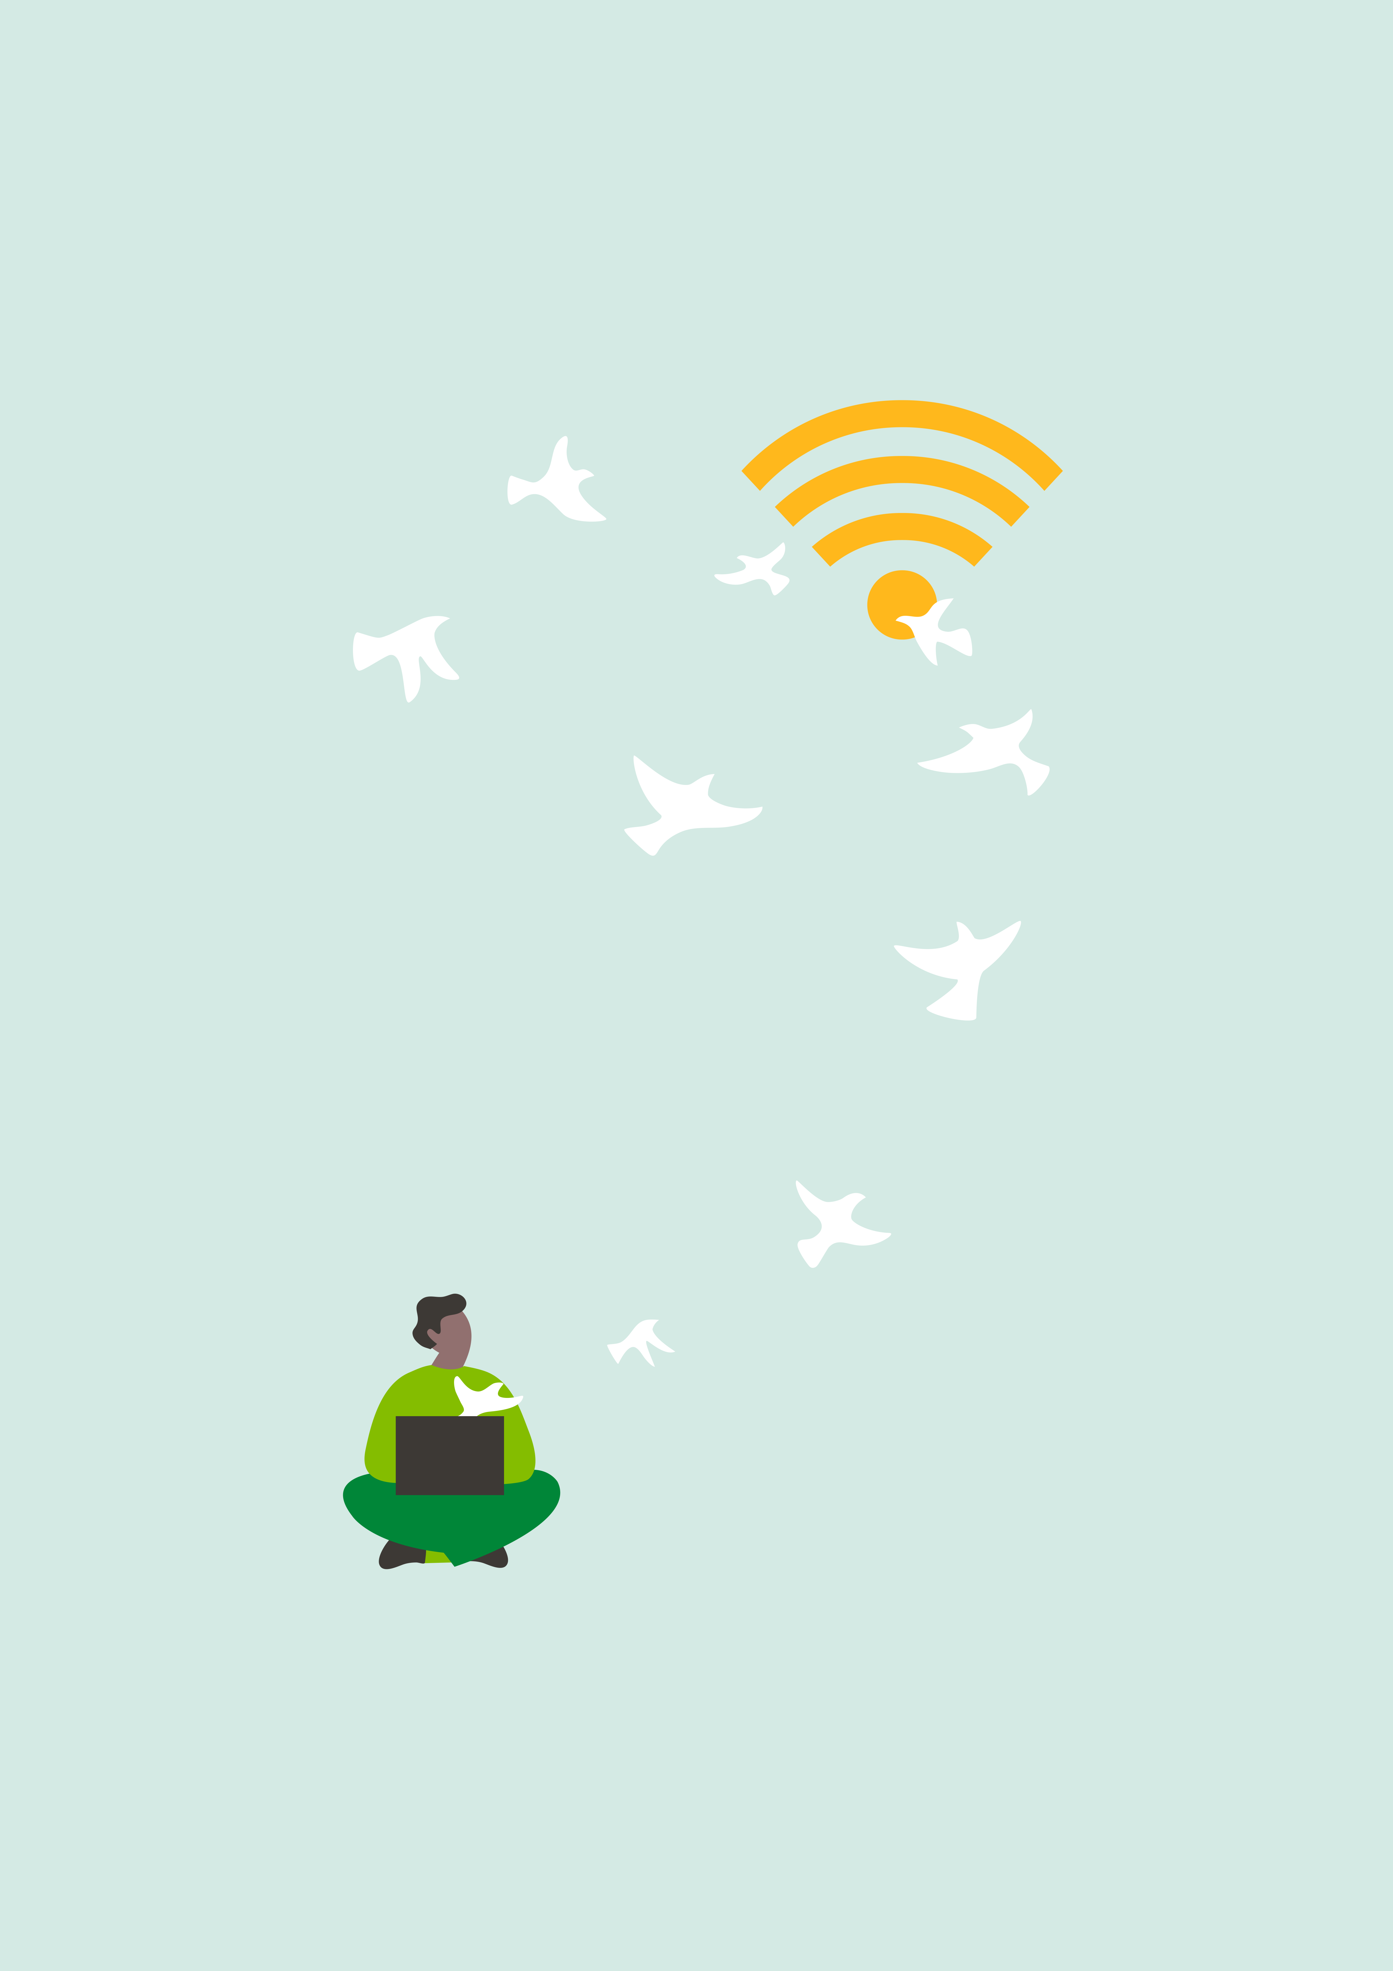


The many faces of inclusive teaching
No Child left behind
Spilamberto, 2017
Cecilia Perillo
Notes:
Today we will try and look at different ways to deal with the inclusive classroom in order to reach all our students. Reaching everyone and leaving no childe behind

Slide 2
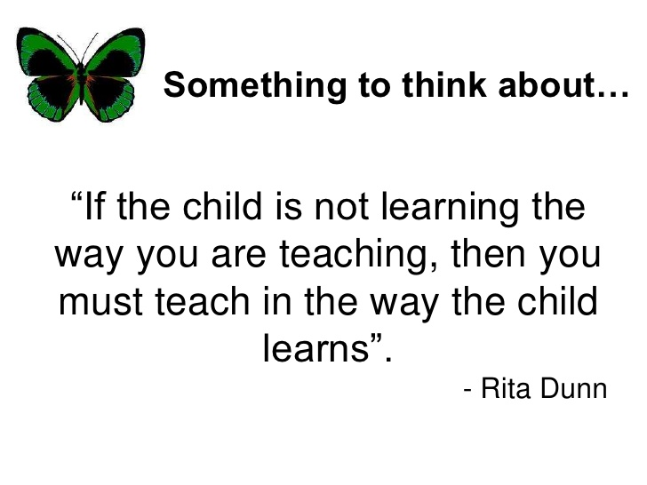
n
Interesting and stimulating way to develop a topic
2. Stimulates curiosity and different responses from different people
Notes:
A quote can be inclusive: stimulates interest and curiosity and can be an introduction to a new topic: Do you agree with the quotation? Why? Why not? Different responses from different people at different levels of competence.We can start a lesson with a quote, we can develop a topic.
We are all different and unique and consequently we bring different experiences and attitudes to the language learning class. Sometimes these differences do not match the one size fits all system and therefore may cause learning difficulties

Slide 3
Session Aims Inclusive classrooms must incorporate a variety of teaching methods in order to reach students of varying learning abilites
Notes:
Session Aims

Slide 4
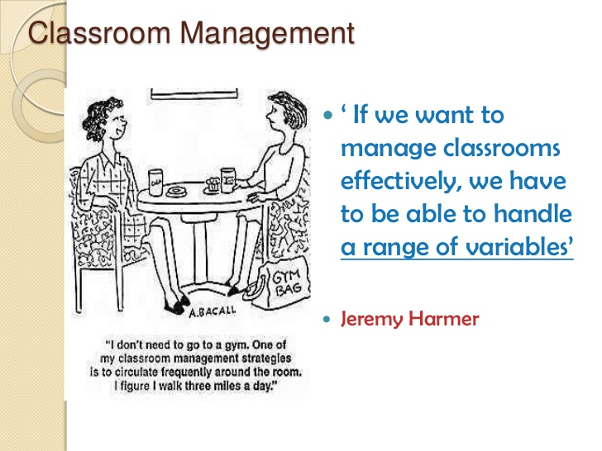
a
Variables
Needs
Interests
Attitudes
Personalities
Experience
Backgrounds
Teaching needs to be sufficiently flexible and well planned in order to reach as many students as possible
Notes:
Writer, presenter, teacher and teacher trainer
As teachers and language teachers we know that there are many variables we need to deal with.

Slide 5
What do you know about your students?
Learning is relating new information or concepts to what we already know
Jim Cummins
Activating prior knowledge is like preparing the soil before sowing the seeds of new knowledge
Jim Cummins
1
Prior - knowledge
2
Can do with language
3
Plan Lessons
Notes:
Depending on the level you teach let’s consider the following:
What do you know about your students’ language skills?
What do you know about their prior knowledge?
How will this information affect your planning?
Jim Cummins
Dr. Jim Cummins is a professor at the Ontario Institute for Studies in Education of the University of Toronto where he works on language development and literacy development of learners of English as an additional language

Slide 6
Strategies to activate prior - knowledge
1
KWL Chart
2
Graphic organisers
3
Concepts maps

Slide 7

Activating prior-knowledge
Thinking about what students already know about the topic
Connect prior knowledge to new learning
A way to scaffold learning for students who process new information more slowly
1. What do students know about volcanoes?
2. What do students want to learn?
3. What students learned from the lesson.
K
Lava comes out of them
Magma flows with lava
W
What are volcanoes made of?
How are they formed?
L
?
?
KWL chart
Notes:
KWL is a graphic organizer that is used during the beginning, middle, and ending of a lesson. The KWL stands for what students know, what students want to learn, and what students learned from the lesson.
It was created by Donna Ogle in 1998, for the purpose of helping students become more active readers of expository, or non-fiction, text. This graphic organizer has since been adopted across content areas, because it requires much less preparation and explanation than more complex organizers and is appropriate for a variety of ages and abilities.
Uses for KWL Charts
KWL charts have a number of uses that engage students in the learning process.
At the beginning of a lesson, KWL charts:
Activate students' background knowledge and get students thinking about what they already know about the topic to get them ready to connect prior knowledge to new learning.
Establish the purpose for the lesson or unit and set the goals for the learning, letting students know what to anticipate from the lesson.
Engage students in asking questions about the new content and pique their curiosity, giving them the chance to share their questions with one another.
During the lesson:
tudents recognize that the lesson is answering their questions. These answers can be written down as soon as they learn them.
Students can keep track of their learning by seeing that they have unanswered questions to follow up on.
Students may add new questions that pop up during their learning as they deepen their understanding of the new concept.
When closing the lesson:
Students use KWL charts to summarize their learning using simple, easily expressed ideas.
Students can compare their take-away learning to their classmates' and add ideas that they left out to make a more comprehensive list.
Teachers can use KWL charts to review the day's learning before changing topics. This is a way to scaffold learning for students who process new information more slowly and to make sure they have a high quality list of important points from the lesson.
Teachers can use KWL charts as informal assessments to determine whether students really got it and how to modify their instructional approach for the students who struggled with the new content.
Use as a study guide for tests

Slide 8
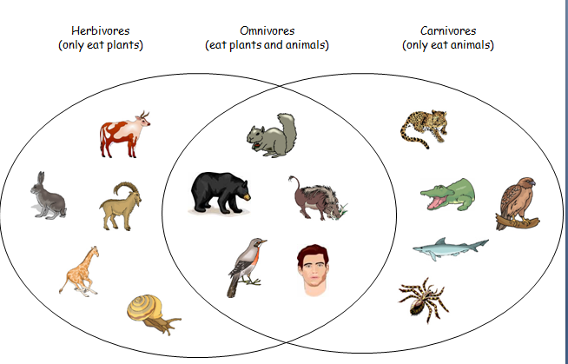
Compare and contrast
Organize information according to similarities and differences
2. Explore relationship
VENN DIAGRAM
Notes:
VENN DIAGRAM: to compare and contrast. A Venn diagram shows relationships among sets of numbers, information or concepts. In around 1880, John Venn introduced the world to the idea of Venn diagrams. Since then they have been used to teach elementary set theory in mathematics, statistics, linguistics and computer science. Using Venn diagrams for reading and in the English classroom allows students to explore relations among ideas. They can use Venn diagrams to organize information according to similarities and differences. Any level of reader can use a Venn diagram to process their thinking around a text. Venn diagrams are useful for comparing and contrasting ideas and are an excellent way to clearly show an overlap of ideas in texts.

Slide 9
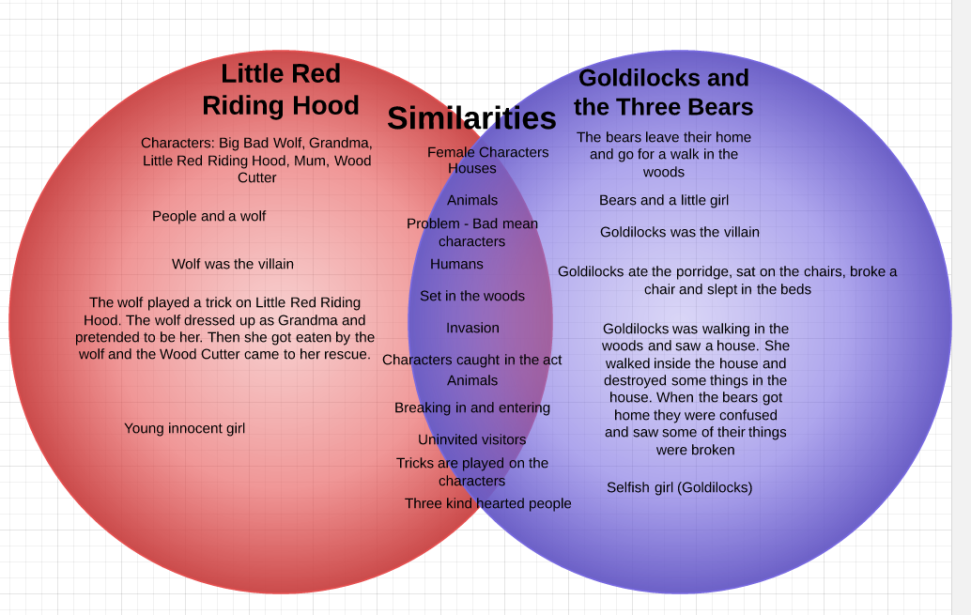

Slide 10
Passport to Secondary School to value pre-existing knowledge
Notes:
A passport to value pre- existing knowledge when primary school children go to scuola media. A way to get to know your students

Slide 11
Solving the problems
1
Half the students have finished
The other half have only just begun
2
3
Graded tasks - readers
Notes:
If stonger students are given more challenging work to do, it is less likely that they will finish quickly.

Slide 12
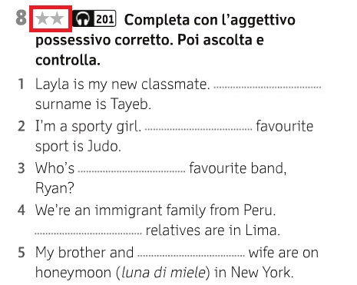
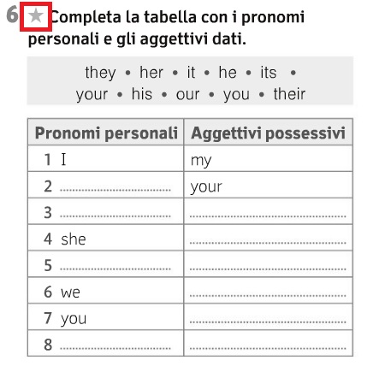
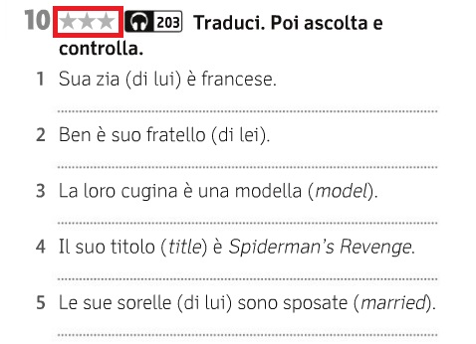
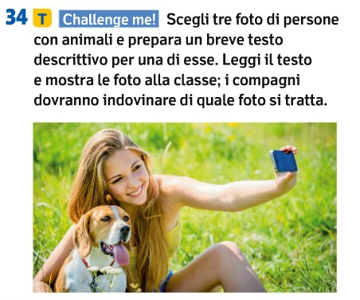
Notes:
The idea is that students work on the same activity but with graded tasks at varying levels of difficulty
Who is feeling tired today? You can do the one star activity

Slide 13
What are the advantages?
1
Appropriate level of difficulty
2
No learner should be left behind
3
Completing the task is motivating
4
Easy learning for all students
Notes:
All students are challenged at an appropriate level of difficulty. No learner should be left behind

Slide 14
The weaker students try so hard but they still get bad marks
Recognition of progress is as important as achievement
Vary your approach to cater for different learning styles
People learn in different ways

Slide 15
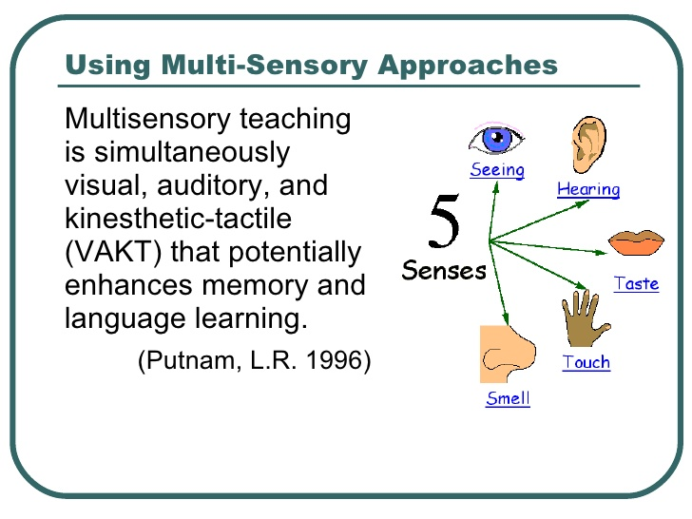
Think about learning styles- are you supporting the learner’s strengths?
Notes:
The use of the strength model will allow many more students to develop their potential through their diverse strengths and interests

Slide 16
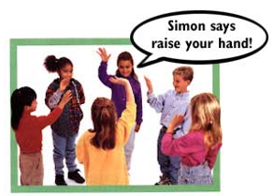
Who benefits from multisensory learning?
Everyone!
1
We learn with our whole body
2
We have a multisensory brain
3
We all have different learning styles
4
People with learning difficulties

Slide 17
To stimulate visual reasoning and learning
Not all visual learners have dyslexia, but all pupils with dyslexia are visual learners
1
Text, pictures, posters, computers, flash cards
2
Colour for highlighting, organizing information
3
Graphic organizers
4
Student created art, images, text, pictures, video
Notes:
We have already seen some examples of visual representation

Slide 18
Sensitizing Students to Grammar
I see!
Many dyslexics have visual strengths so use of colour makes comprehension easier and helps them to focus and remember
I see!
Word order
Colour helps to build sentences
Visualising = understanding
Subject | Verb | Prep | Article | Adjective | Noun
We go to a big school
Notes:
Recognise word order/colour code to construct sentences /The visual dimension to grammar. Visualising is synonymous with understanding. We can show students how grammar operates.Using colour makes the excercise easier for them and helps with memory
Why is it colour coded?
REMEBER if pronoun is red, make sure it’s ALWAYS red. Be consistant

Slide 19
Adjective | Pronoun | Noun | Verb | Prep | Article
he watch a the on cushion in fluffy an kitten I reads brown climbs book up drives they she tree long drink monkey sits expensive TV good coffee bed car hot bar film
Notes:
I might leave this one out/ to be more inclusive we go from this to the next slide

Slide 20
Adjective | Pronoun | Noun | Verb | Prep | Article
hot | he | coffee | drink | in | the
fluffy | she | bar | reads | on | a
brown | they | book | sits | up | an
expensive | we | bed | climbs
good | I | monkey | watches
long |  | tree | drive
 |  | film car

Slide 21
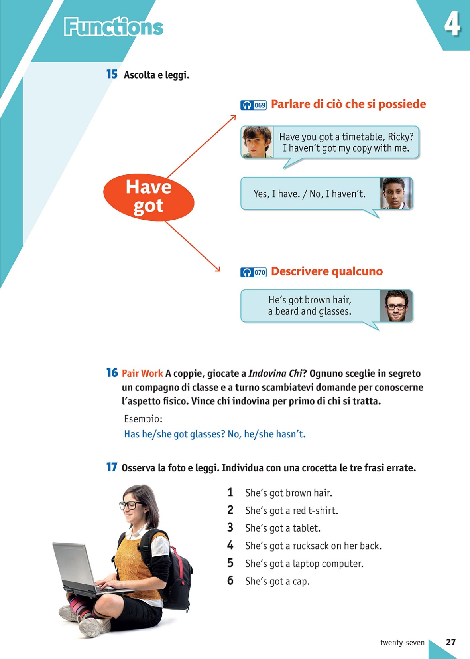
Notes:
Chunked language + use of colour
Visual reminder of how language functions
Easier to learn this way

Slide 22
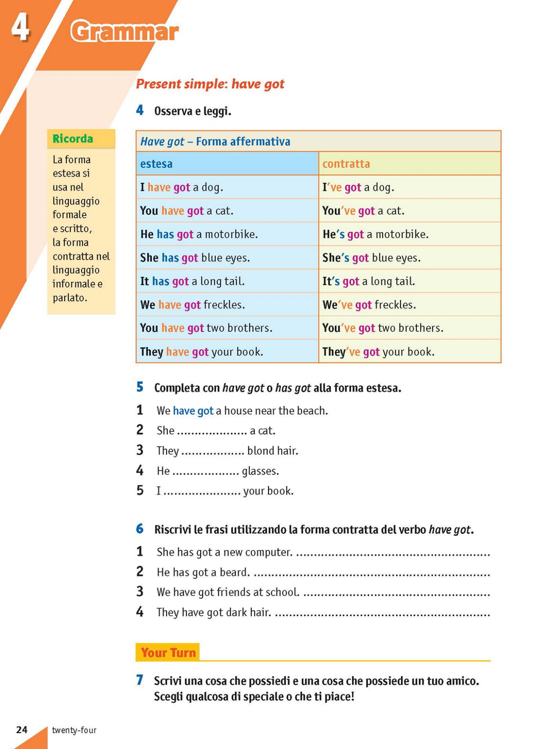
Notes:
To Easy learning booklet

Slide 23
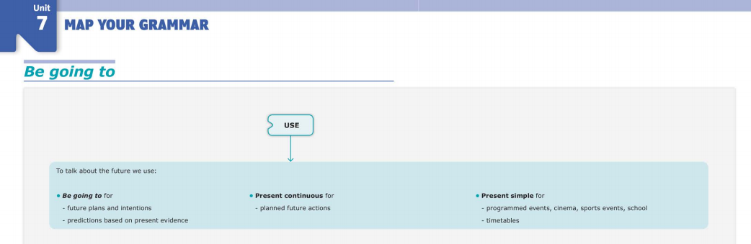
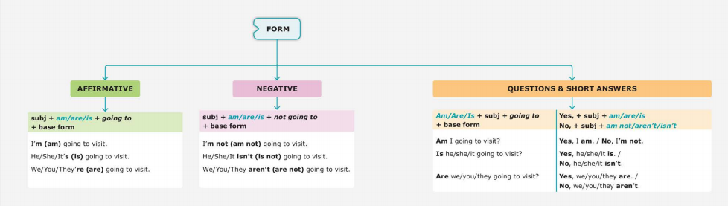
MAP YOUR GRAMMAR
Notes:
Scaffolding

Slide 24
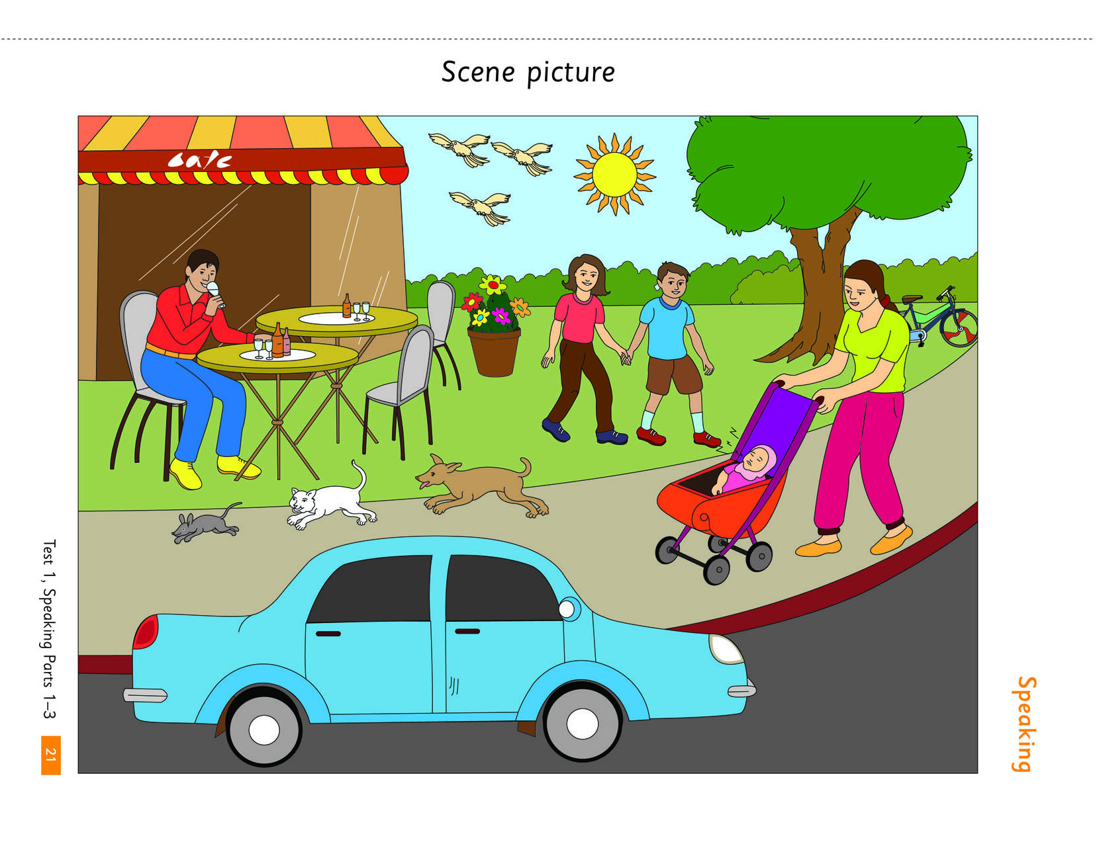
Memory Game
Notes:
Posters and illustrations can also be used for memory games. Memory games can revise different lexical items such as numbers, colours and clothes and also structures, such as the present continuous. They can be done orally or written, in pairs in teams as a competition or individually as a test. Here is an example: I’m going to show you a picture for 30 seconds and I want you to remember as much as possible about it. This picture is taken from Pearson STARTERS practice tests plus

Slide 25
WHAT CAN YOU REMEMBER FROM THE PICTURE?
Memory Games
Revise different lexical items such as numbers, colours, clothes
2. Revise structures such as present continuous
3. Orally or written
4. Individually, pairs, teams
5. Test
1.What animals are there?
2. What’s the weather like?
3. How many birds are there?
4. What is the man doing?
5. How many children are there?
6.What colour is the car?
7. What is the mother wearing?
8. What is the baby doing?
Notes:
What can you remember from the picture?
1. What animals are there? (mouse. Cat, dog, birds)
2. What’s the weather like? (sunny)
3. How many birds are there? (3)
4. What is the man doing? (drinking)
5. How many children are there? (3 boy, girl and baby)
6.What colour is the car? (blue)
7. What is the mother wearing? (green T-shirt , red trousers, yellow shoes)
8. What is the baby doing? (sleeping)
All this language work originally came from just two posters and shows that the teacher doesn’t have to keep inventing and looking for new visual material but can reuse what s/he already has but in different ways.

Slide 26
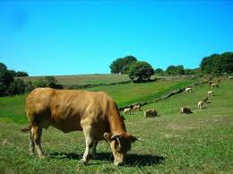
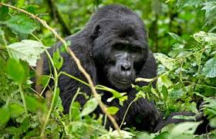
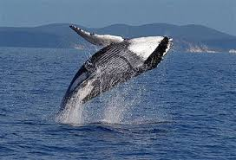
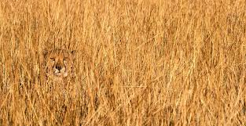
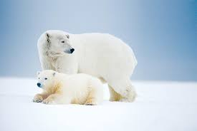
Presentation -What’s the lesson about? Subject?
Science :Animals and their habitats

Slide 27
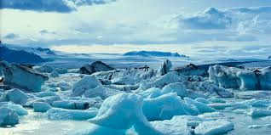
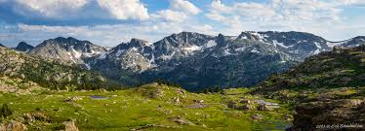


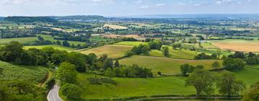

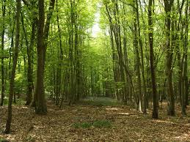
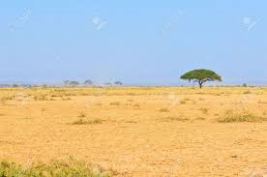
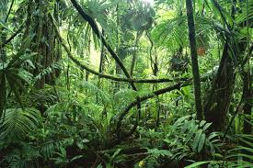
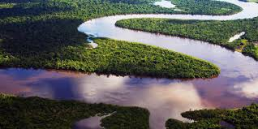
Presentation
arctic
mountains
desert
lake
country
ocean / sea
forest / woods
river
savannah
jungle
HABITAT: The natural environment where an animal lives

Slide 28
DRAMA
Interview a Roman
Act out a story
SCIENCE
How an aqueduct works
HISTORY
Social Classes
Architecture
CLIL Project
Central theme
Explore and relate other curricular subjects/ideas
The Ancient Romans
ART
Make a mosaic
Construct an amphitheatre
GEOGRAPHY
Map of Empire
Map of trading routes
RELIGION
Roman gods and godesses
Notes:
One way that projects can be developed and structured is by starting from a central theme and then to explore what other curricular subjects and ideas can be related to this central theme. This can be represented on a mind map or web.
So for example, in the 4th or 5th year children may study the Ancient Romans in their Italian History lessons.
We can take this as our central theme for an English project and also see how we can bring in other curricular subjects.
These are just some ideas – I’m sure you have many more.
This could be a way of approaching CLIL particularly favourable to the teacher who not only teaches English but also history, science or geography for example. These teachers will already have the content knowledge at their finger tips.
CLIL is an inclusive way of teaching, buiis ablding information through project work. Catering for all. Including everone, taking pressure off ss who cannot learn through rules and learning and consolidating concepts-curricular subjects-there is something for all – ss learn about roman times
One way that projects can be developed and structured is by starting from a central theme and then to explore what other curricular subjects and ideas can be related to this central theme. This can be represented on a mind map or web.
So for example, in the 4th or 5th year children may study the Ancient Romans in their Italian History lessons.
We can take this as our central theme for an English project and also see how we can bring in other curricular subjects.
These are just some ideas – I’m sure you have many more.
This could be a way of approaching CLIL particularly favourable to the teacher who not only teaches English but also history, science or geography for example. These teachers will already have the content knowledge at their finger tips.

Slide 29
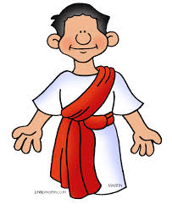
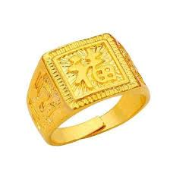

Drama Story prediction – What’s it about?
ring
Senator
thief
Notes:
First let’s get students to predict the story. This will help them greatly in comprehension when they read it for the first time
and is also a way to introduce key vocabulary
TRAINER : Ask teachers to predict what they think the story will be about

Slide 30
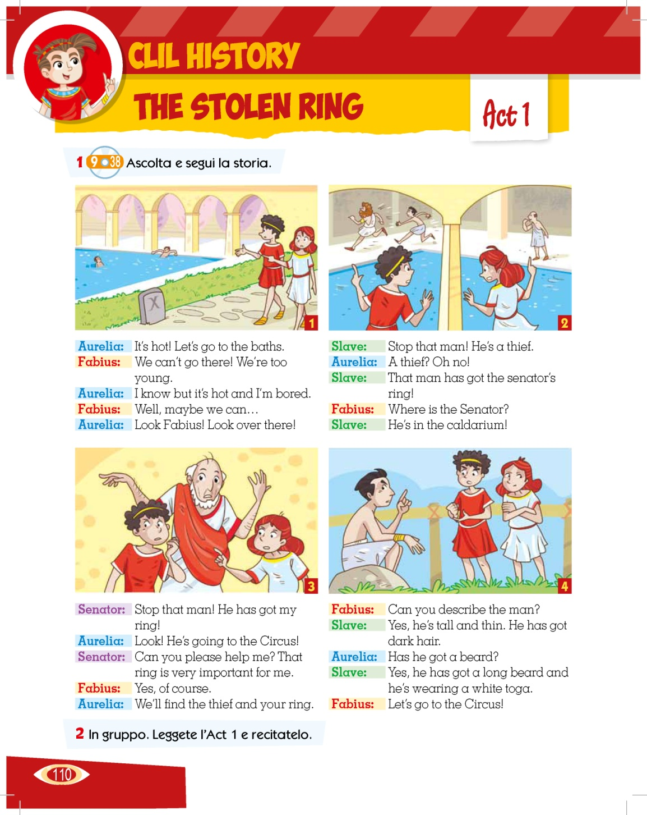
History
and
Drama
Drama is a great way to implement the VAKT model for learning.
2. Consolidate and reinforce language and knowledge
3. Takes information off the page and comes alive!
Global questions
Where are Aurelia and Fabius?
Where do they go?
Detailed questions
How does Aurelia feel?
What has the thief got?
Where is the Senator?
Where is the thief going?
Describe the thief.
Notes:
It’s important not to forget drama when doing project work. Drama is a great way to implement the VAK (visual, auditory and kinaesthetic) model for learning.
Using drama is a great way to consolidate and reinforce language and information learnt through reading, writing and worksheets etc. It can literally take information off the page and make it come alive.
And of course, with less focus on writing and formal reading and language learning it can take the pressure off DSA students and help build their confidence through a more manageable learning medium.
Next we can get the students to listen to and read the first act and ask them some basic questions to help global understanding of the story
Then we can get the students to listen and read a second time and ask them some specific questions about each section of the act.
This will help them not only understand but familiarize themselves with the language

Slide 31
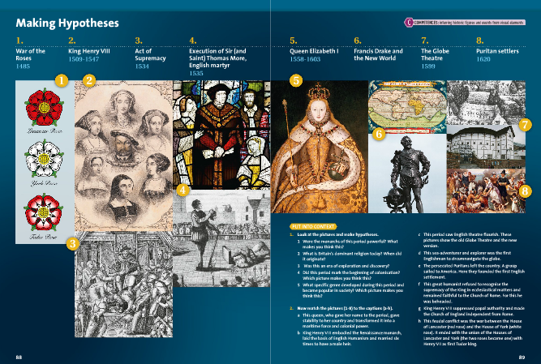
Insert examples of Amazing Minds – reading activities and projects
Notes:
Inclusive way of presenting information. Element of choice, listening, visualise

Slide 32
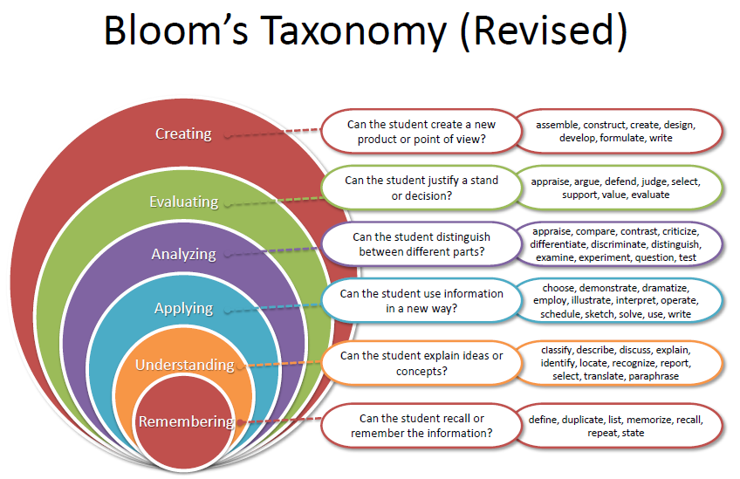
Notes:
Students with Learning Difficulties
For children with learning difficulties Bloom's taxonomy provides the opportunity to use key skills from the matrix that allows them to demonstrate in many ways that they have achieved the task provided to them. Sometimes it is hard for the students to be able to see the strengths they have in certain learning areas but through Blooms they are able to clearly see their strengths. Often the assumption is made that if the child isn't exhibiting strengths in certain intelligences then they are identified as having a 'learning disability' but another way of framing those assumptions is that those intelligences are "lower down in their profile of relative intellectual strengths." (McGrath & Noble, pp.43, 2005). If a child displays any sort of development delays the six intelligences are still valuable. The matrix provides teachers with the tools to make an individualised program that allows them to participate in the same unit as the rest of the class, but at the level that is appropriate for them. Through the matrix students are provided with the opportunity to practice and reinforce key learning skills and concepts through the different tasks that can arise from the six intelligences. This benefits them as it doesn't just have to be the same task repeated over again.
Life is all about Solving Problems and BT is all about helping our students to solve problems in the ‘best’ of ways
.
Our goal is to help students not only to learn information but also to improve cognitive ability.
In other words, to help improve students’ ability to think and not just memorize information.
Memorizing is not the same as thinking and understanding
Helping someone improve their thinking skills is not an easy task, but BT can help us reach our goal.
BT is a list of cognitive skills, from lower to higher, that is used by teachers to determine the level of thinking students have achieved.
Each skill represented here is a building block and it is important to start from the lowest level.
We can use Bloom's Taxonomy as a sort of checklist to make sure each student can demonstrate every cognitive skill on the taxonomy. What learners can ‘practically’ do with each skill.
It can also be used as a checklist for learning objectives related to course books
HANDOUT FOR TEACHERS-
In groups, I would like you to familiarise with the Taxonomy: as you can see there is a division between lower and higher order thinking skills and related actions and products- the blank space is for you to write related activities connected to your subject
HISTORY IN ENGLISH
THE CRISIS OF 14TH CENTURY EUROPE
PAGE 5.
ED. SCOLASTICHE
BRUNO MONDADORI
In groups observe both the taxonomy and the photocopy of the objectives of the history lesson and decided which cognitive skill is being developed for each/an activity. Map the objectives with the taxonomy.
Bloom’s Taxonomy in its various forms represents the process of learning. It was developed in 1956 by Benjamin Bloom and modified during the 1990′s by a new group of cognitive psychologists, led by Lorin Anderson (a former student of Bloom’s) to make it relevant to the 21st century.
The revised taxonomy emphasizes what a learner “Can Do” at each level.

Slide 33
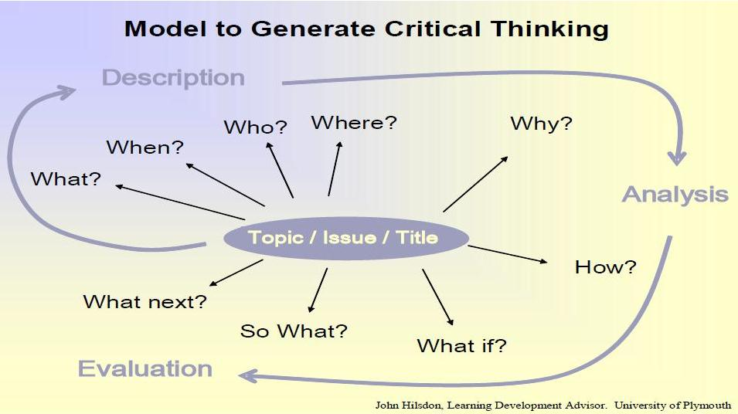

Slide 34
Auditory techniques
1
Computerized text readers
2
Music, song, rhymes
3
Video / Film
4
Flipped Classroom

Slide 35
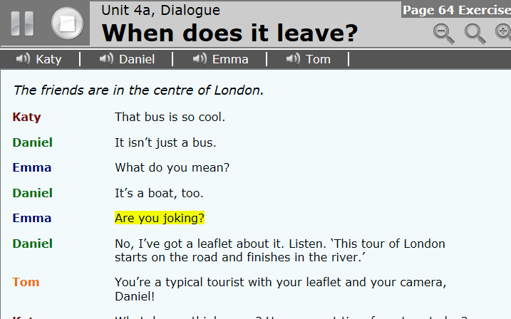
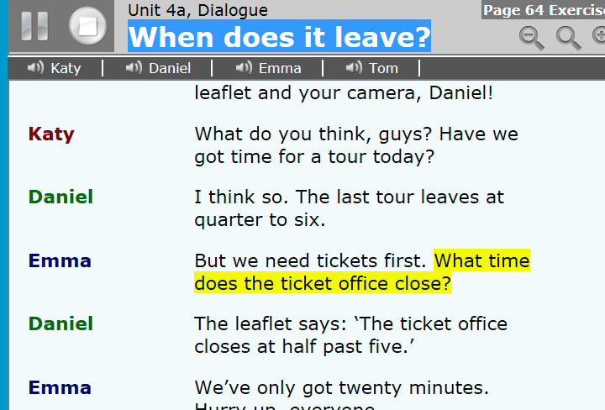
Computers are infinitely patient
Computer-based exercises look appealing
Highly motivating and
multi-sensory
4. Supports learning at all levels

Slide 36
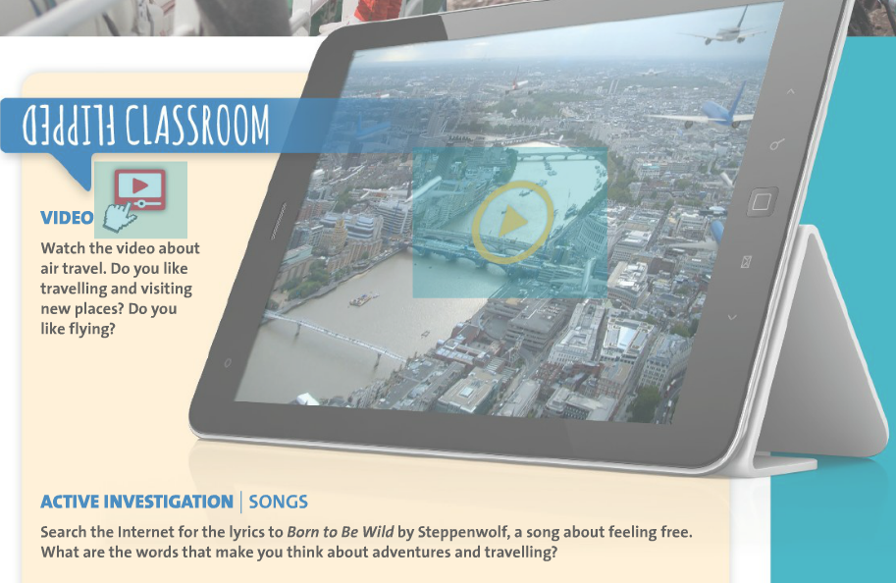
Notes:
The flipped classroom is a pedagogical model in which the typical lecture and homework elements of a course are reversed. Short video lectures are viewed by students at home before the class session, while in-class time is devoted to exercises, projects, or discussions.
Activity
Imagine you are about to teach a unit in your coursebook about Education. Can you think of a flipped classroom activity you could use before starting your lesson to introduce the topic of the unit? Think about the activity type and refer to Bloom’s taxonomy to help you identify which type of activity might be suitable. What support would you need to build in to the flipped activity to ensure it was achievable? (show vocab maps from mapstore when getting feedback

Slide 37
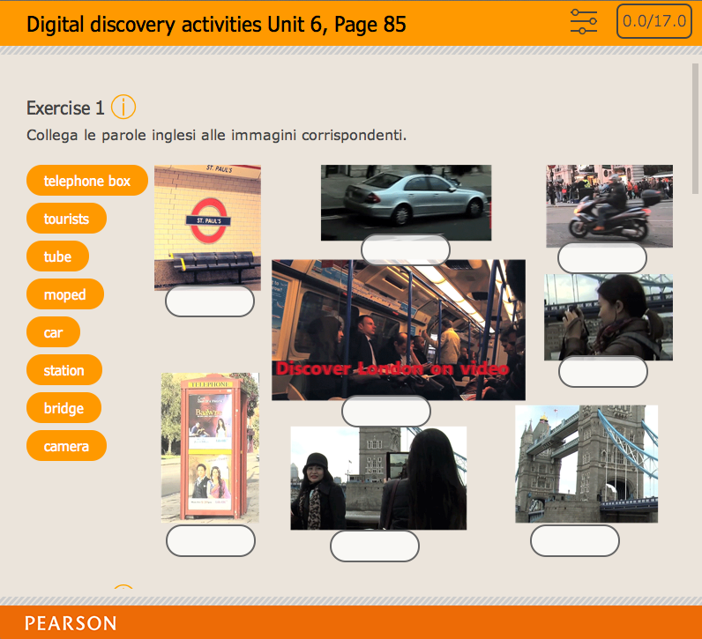
Tactile teaching methods
1
Finger painting
2
Puzzles
3
Computer
Notes:
Multi sensory techniques that involve using the sense of touch are called tactile methods. Tactile methods include strategies such as:
finger paints and puzzles to improve fine motor skills
Modeling materials such as clay and sculpting materials
Using small materials called manipulatives to represent number values to teach math skills

Slide 38
Kinaesthetic teaching methods
We remember 10 per cent of what we hear, 20 per cent of what we see, and 90 per cent of what we hear, see and do
1
Body movements
2
TPR
3
Reading race
Notes:
Kinesthetic methods
Multi sensory methods using body movements are called kinesthetic methods. These involve fine and gross motor movements.
Games involving jumping rope, clapping or other movements paired with activities while counting and singing songs related to concepts.
Any large movement activity for students involving dancing, bean bag tossing or other activities involving concepts, rhythmic recall and academic competition such as quizzes, flash card races and other learning games.

Slide 39
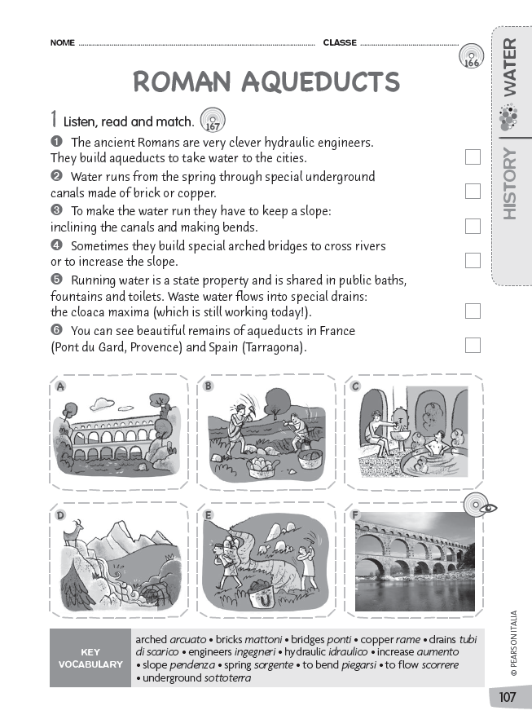
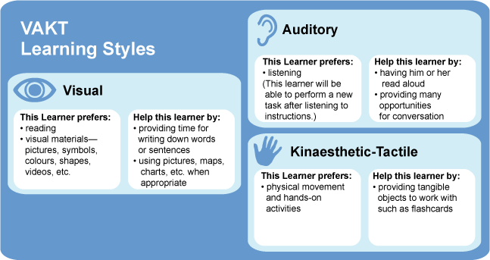
History and Science
Reading Race
1. Cut up text
2. Place around classroom
3. Give out pictures to pairs of students
4. They race to match picture and text
Notes:
Associating movement helps memory, right picture with right word to improve comprehension. Division of text makes it manageable, pair work to support each other. Png puting together is kinaesthetic.

Slide 40
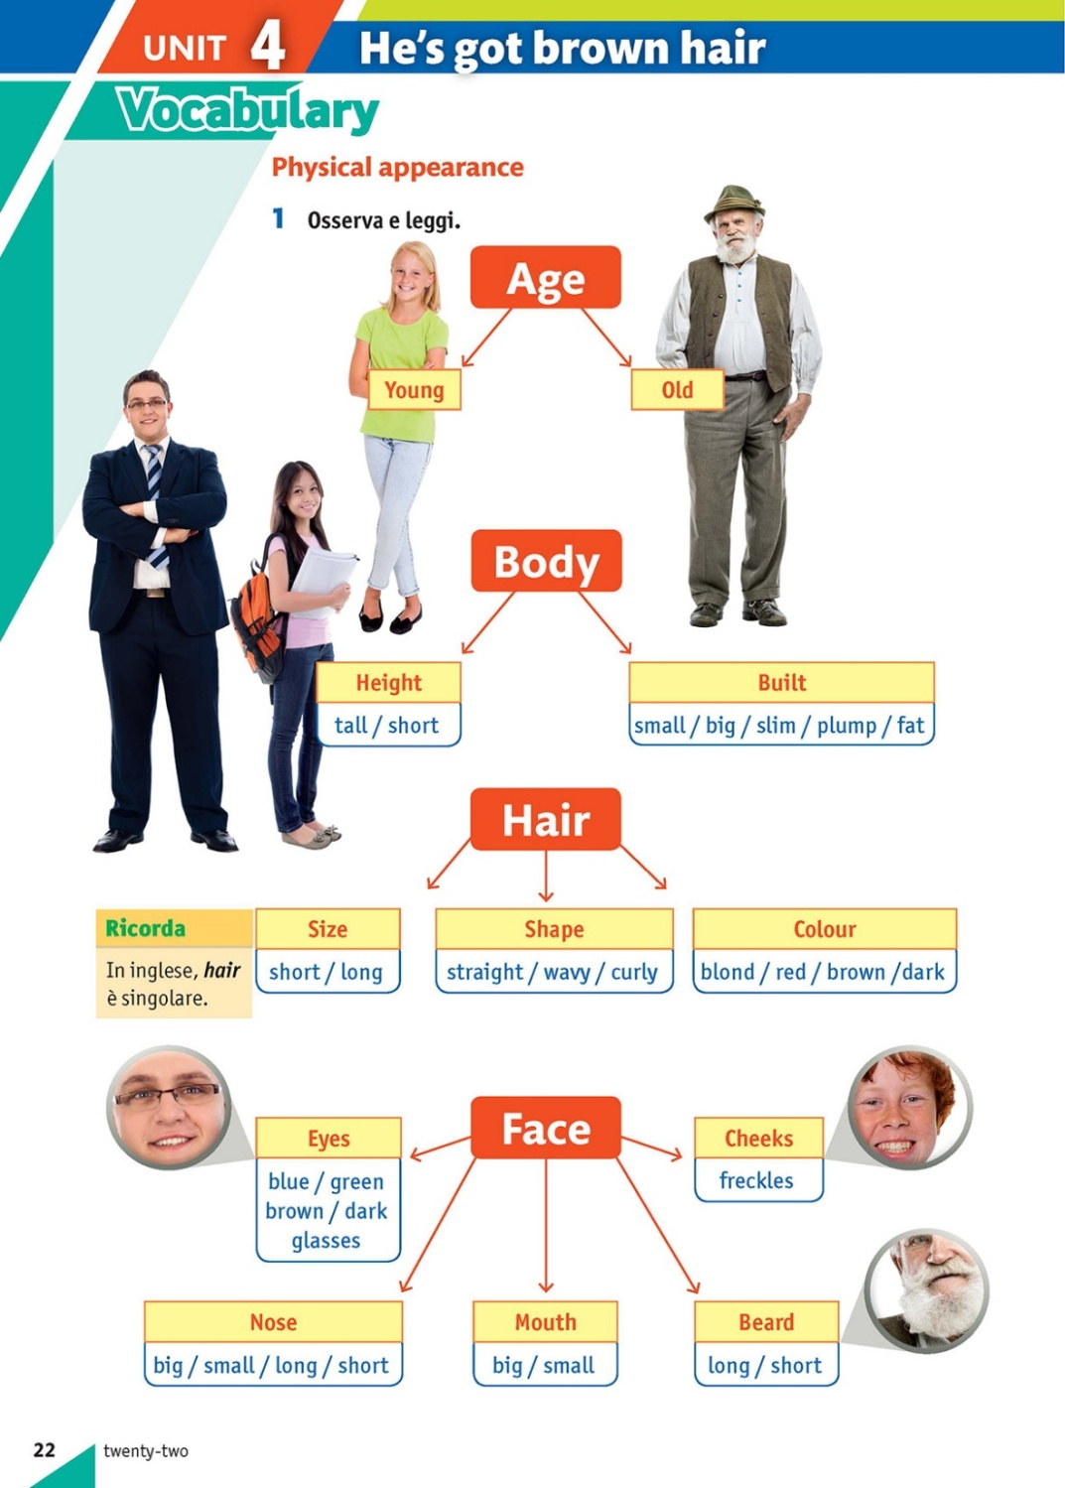

Slide 41

The Hokey Cokey
Put your right arm in
Put your right arm out
In, out, in, out, shake it all about
You do the hokey cokey
And turn around
That’s what it’s all about
Oh, the hokey cokey! ( 3 times)
Knees bent, arms stretched
RA,RA, RA!
Put your left arm / right leg / left leg / whole self in………………………

Slide 42


Slide 43

John Dewey
« If we teach today’s students as we taught yesterday’s, we rob them of tomorrow»
Notes:
Reflection
John Dewey, (born Oct. 20, 1859, Burlington, Vt., U.S.—died June 1, 1952, New York, N.Y.), American philosopher and educator who was a founder of the philosophical movement known as pragmatism, a pioneer in functional psychology, and a leader of the progressive movement in education in the United States.Jan 11, 2010
Discuss with teachers
I think this sums up the idea that we need to focus on change. Change in what we are doing in the classroom??? Are we preparing them for tomorrow?

Slide 44
Grazie per la partecipazione! formazione.elt@pearson.it

Slide 45
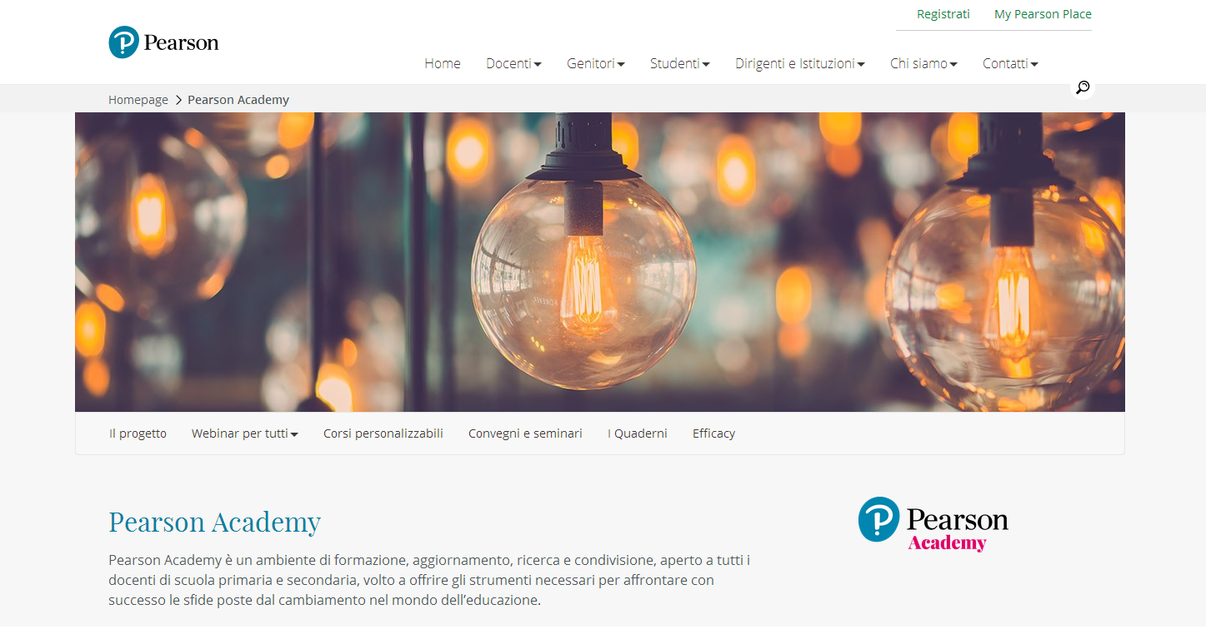
it.pearson.com/pearson-academy.html

